Slide 1
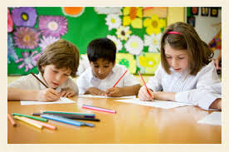
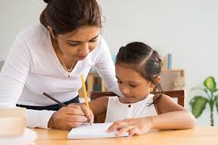
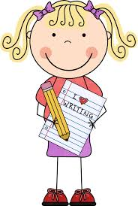
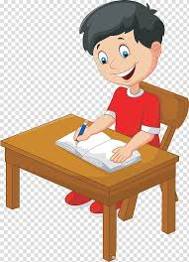
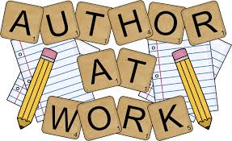
Year 1
Writing

Slide 2

Handwriting
When your child is doing any writing at home, it is important that they are forming their letters correctly. The handwriting mat below shows where your child should begin each letter and the direction they should follow when forming their letters. Please help to correct your child, if they are forming any of their capital or lower case letters incorrectly.

Slide 3
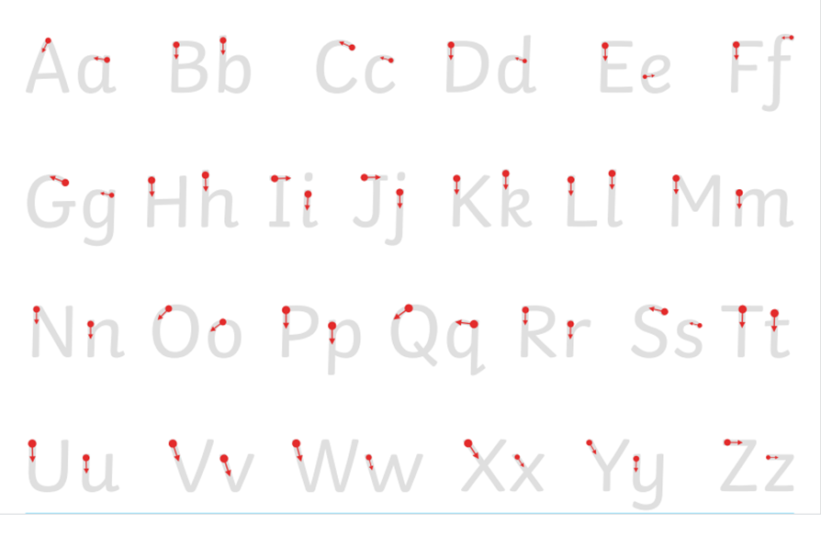

Slide 4
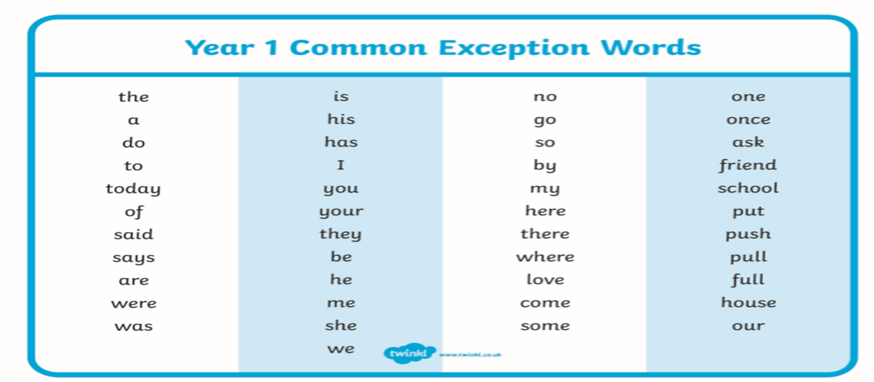
Spelling
Year 1 children are expected to be able to spell many of the Year 1 common exception words below correctly.

Slide 5
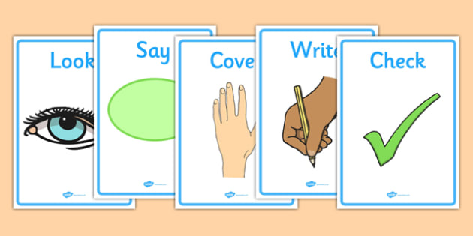
Practise spelling the common exception words, using the look, say, cover, write, check method.
Look- Study the word
Say- Say it aloud a few times.
Cover- Cover it up with a piece of paper or your hand.
Write- Write the spelling next to the original word.
Check- Check your spelling to see if you’ve got it right.

Slide 6
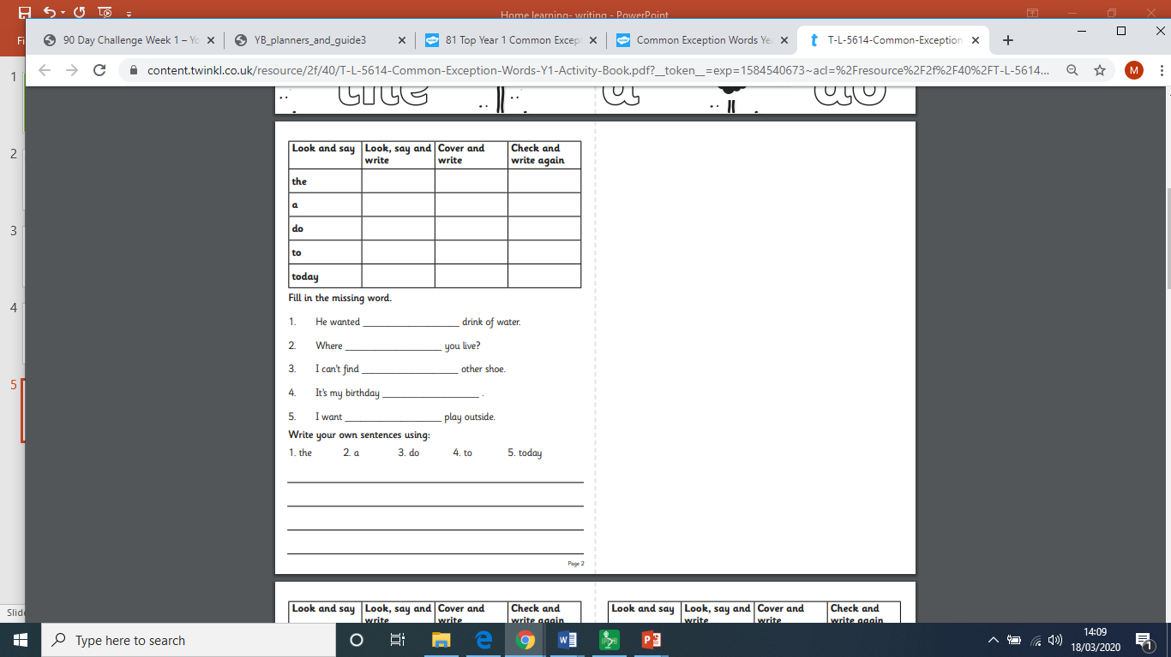



Print out or draw your own spelling grid like the one
on this page.
Practise each spelling using the
‘Look, Say, Cover, Write, Check’ method.
Fill in the missing word. Can you spell the word correctly
without looking at the spelling grid?
Finally, write your own sentences, using each common
exception word. Remember your capital letter at the
beginning of your sentence and full stop at the end.

Slide 7
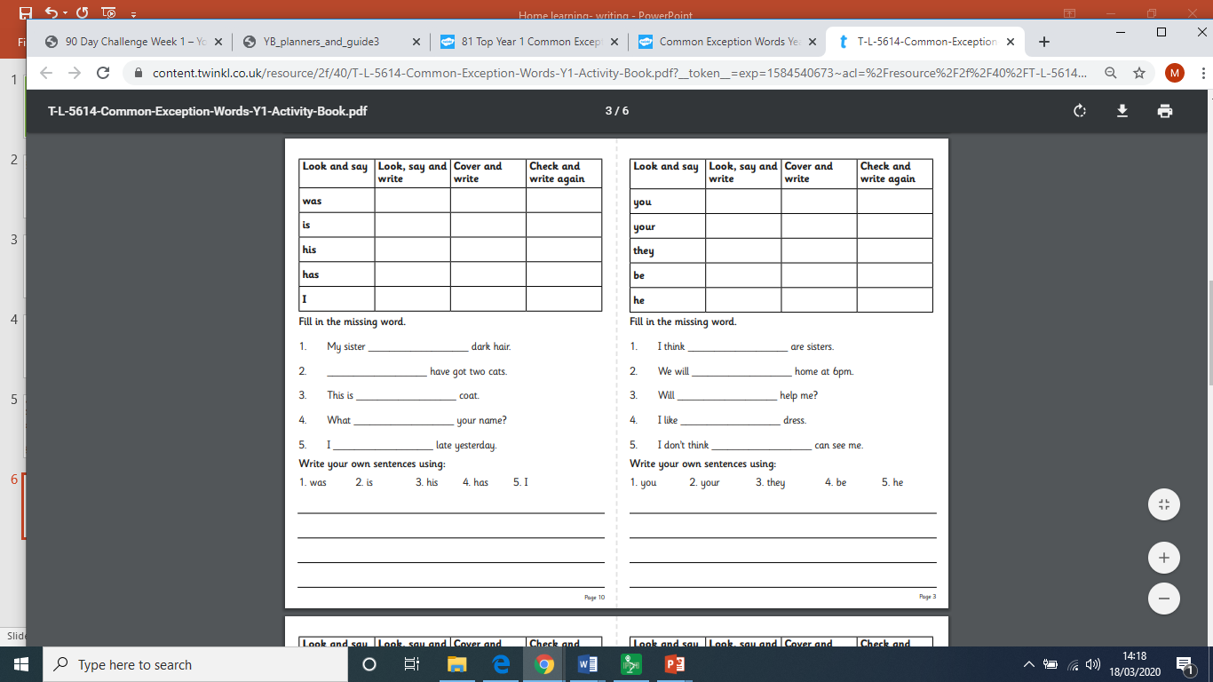

Slide 8
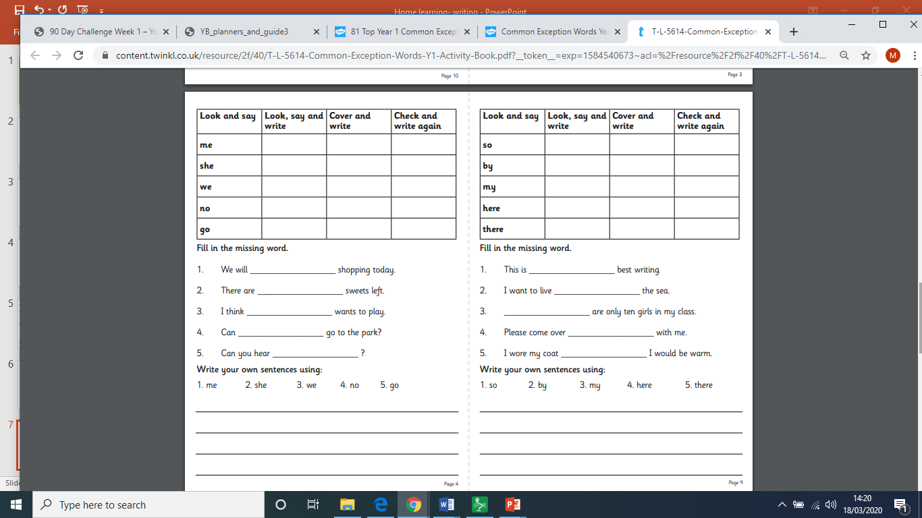

Slide 9
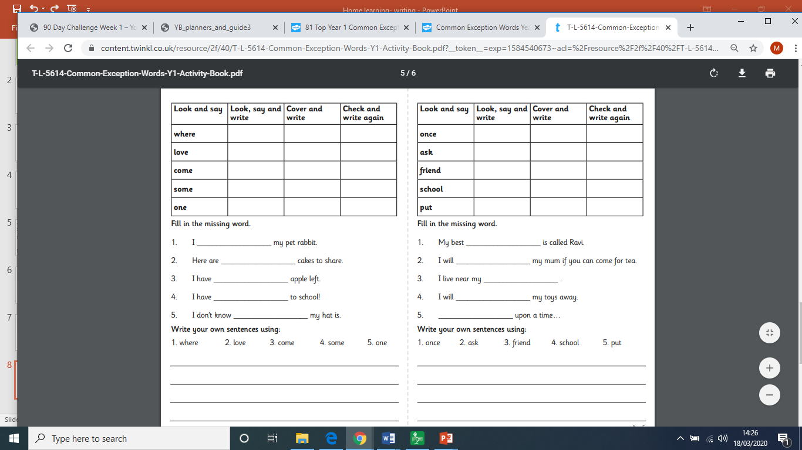

Slide 10
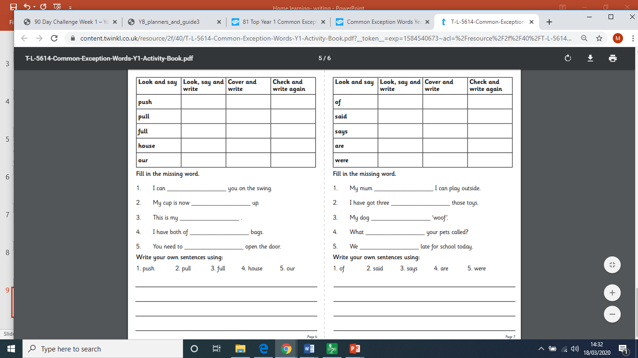

Slide 11
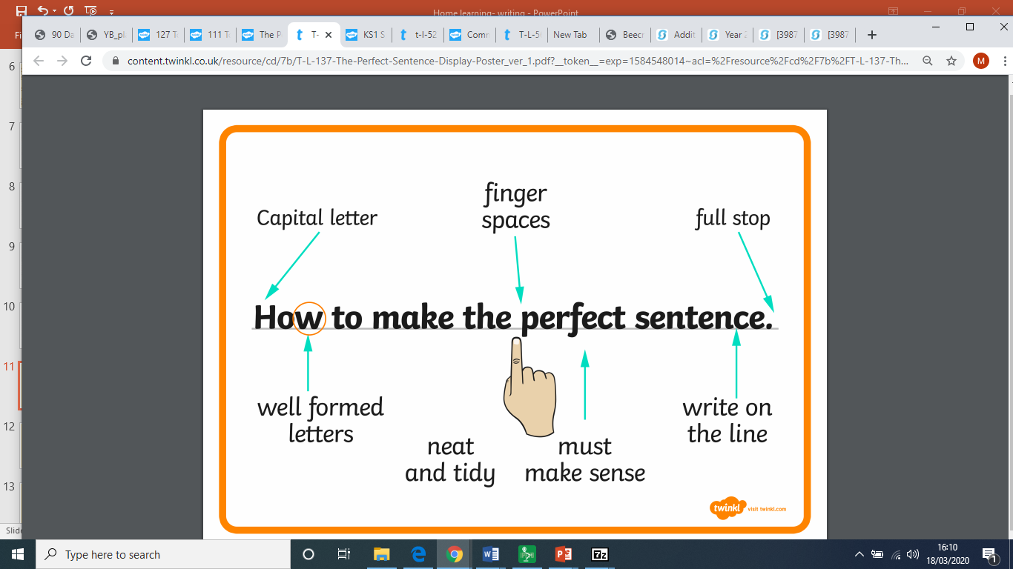
Writing Sentences
Year 1 children should be able to write simple sentences, using a capital letter at the beginning and a full stop at the end. They should use spaces between words and use their neatest handwriting.

Slide 12
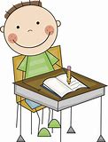
Encourage your child to write simple sentences by using this fun sentence scrambling game. Remind your child to look for words that begin with a capital letter and end with a full stop. This will help your child to order the words correctly. The sentences should be written on paper or in a writing book.
Writing Sentences

Slide 13
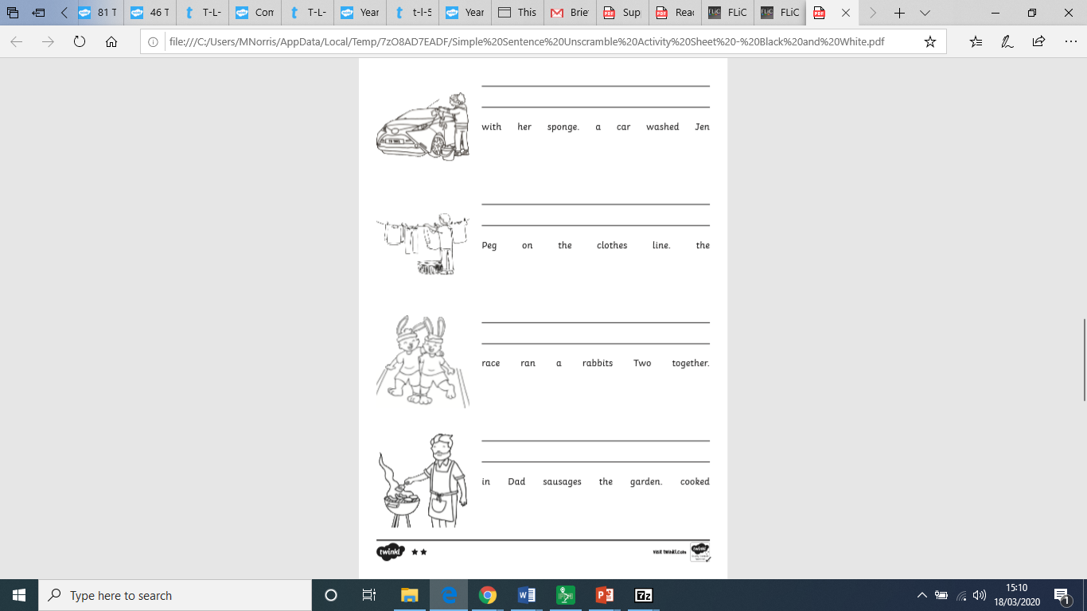

Slide 14
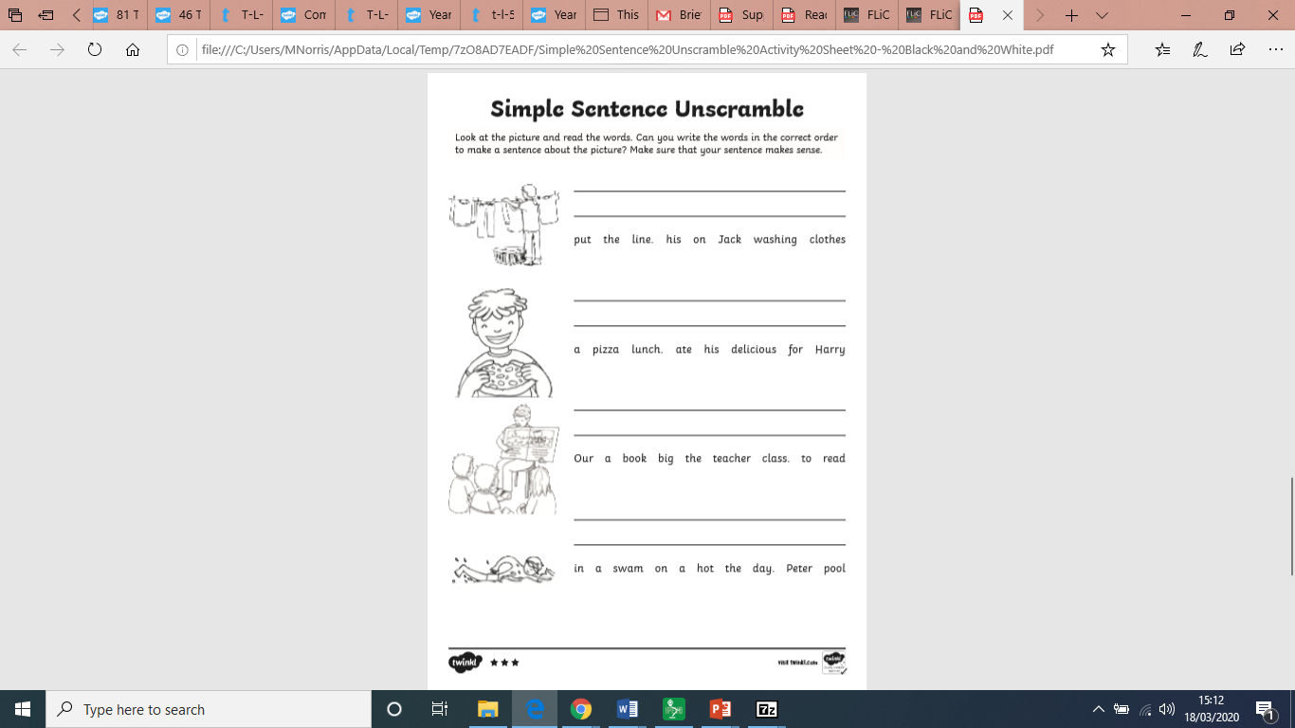

Slide 15
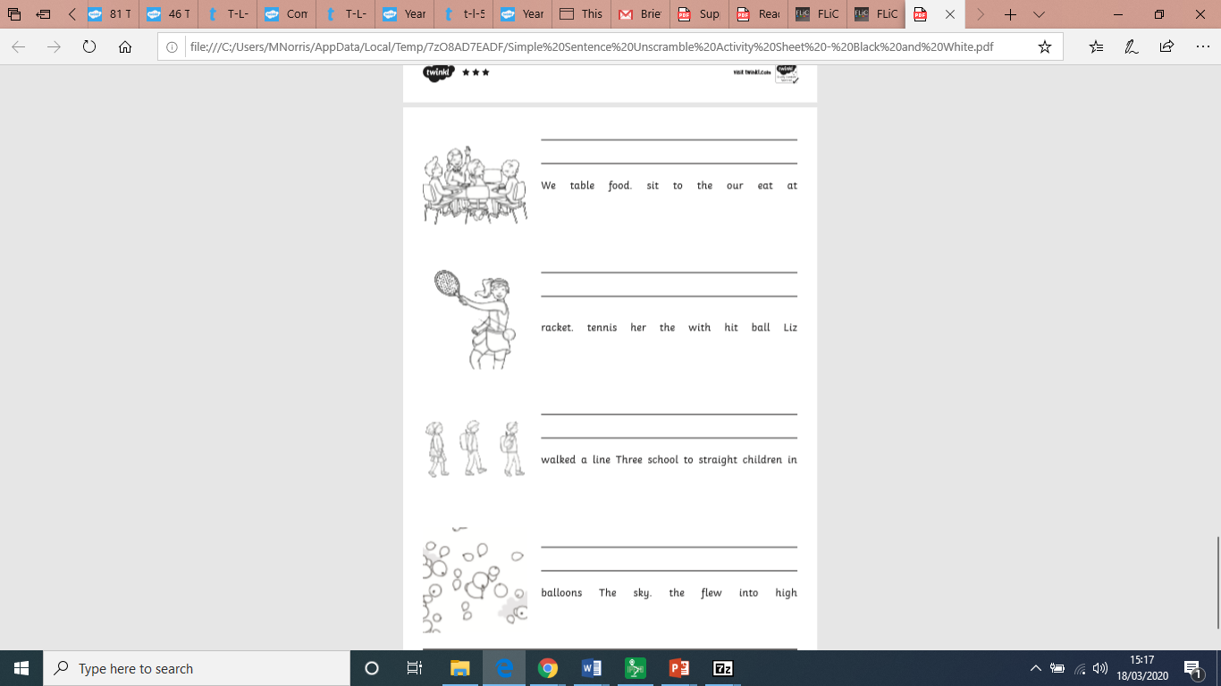

Slide 16

In Year 1, children are taught how to write narratives including stories and descriptions. They are encouraged to use conjunctions such as ‘and’ and adjectives to make their sentences longer and their writing more interesting for the reader.
Use the following picture prompts to help you write some interesting sentences in your writing book.

Slide 17
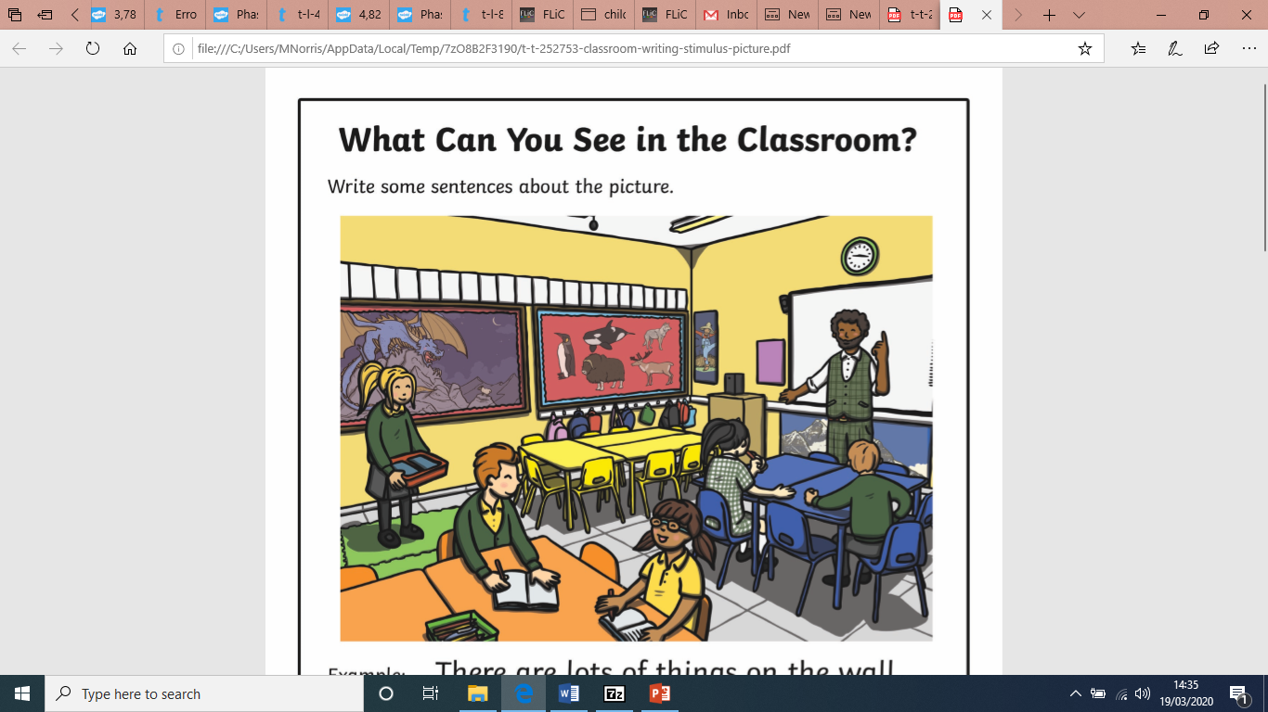
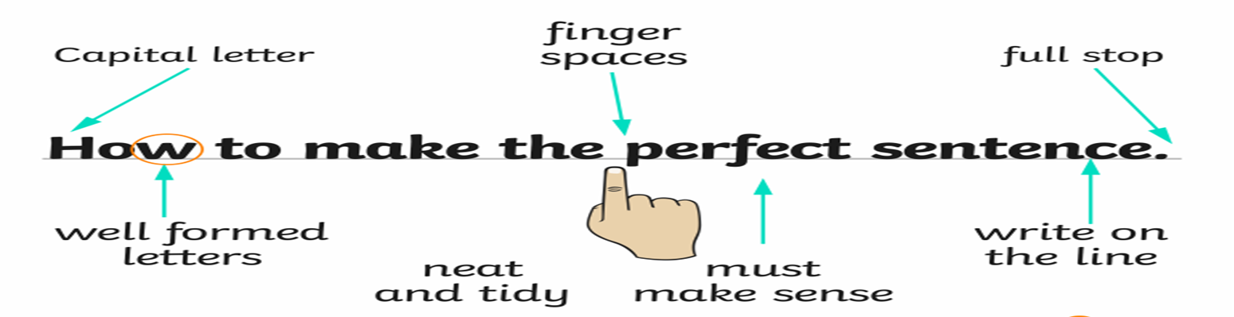
Example- I can see a little girl with blonde hair and a happy boy writing in his book.

Slide 18
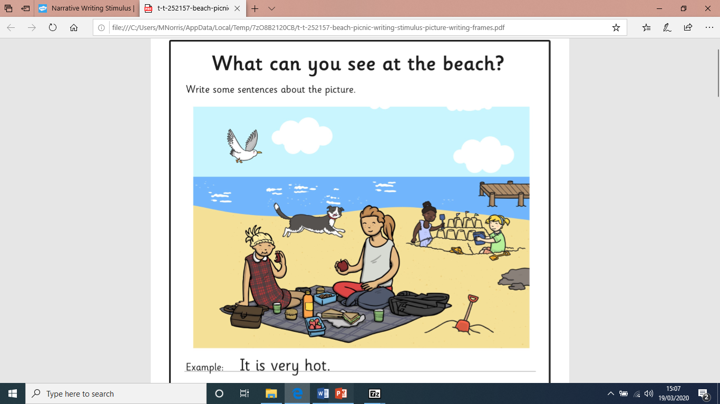
Example- The children are happy because the yellow sun is shining.
The white seagull is looking at the shiny apple and the
delicious sandwich.

Slide 19
