Slide 1





Year 1
Reading

Slide 2
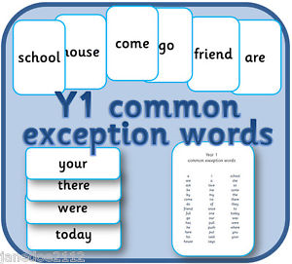
Common Exception Words
Common exception words are the ‘tricky’ words that don’t follow the usual spelling rules.
These are the Year 1 common exception words that children are expected to be able to read.

Slide 3
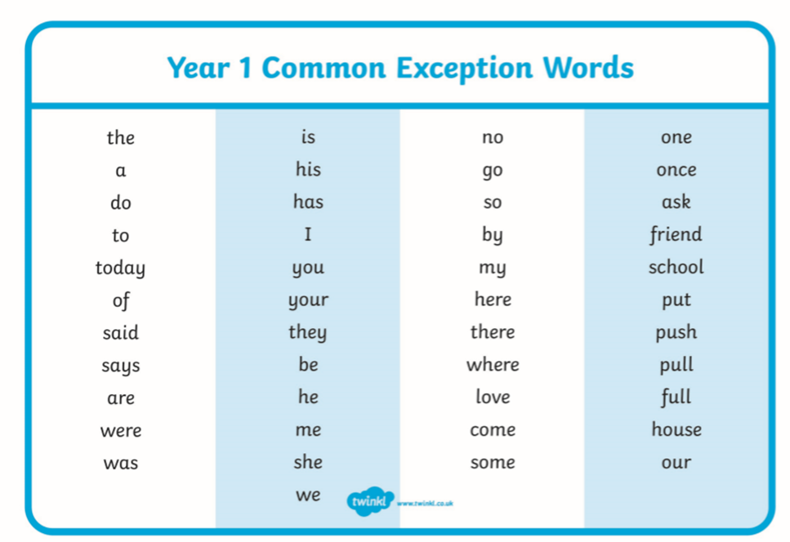
.
You could make your own Year 1 flashcards by writing the words on paper, card or post-it notes. How many of the words can your child read? Practise reading the words with your child ‘little and often’. Can they find and read the words in their reading books?

Slide 4
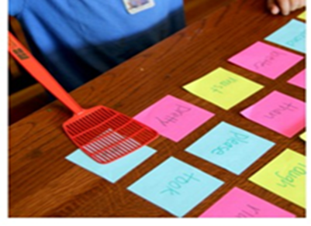
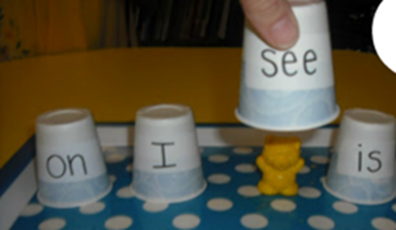
Fun ways to practise the common exception words
1.Write the words on post-it notes. Adult to call out one or
more of the words and child to find them and
hit with a fly swatter.
2. Write a selection of the words on paper or plastic cups. Hide an object such as a plastic animal underneath one of the cups and ask child to find the hidden object. They must be able to
read the word before lifting the cup.

Slide 5
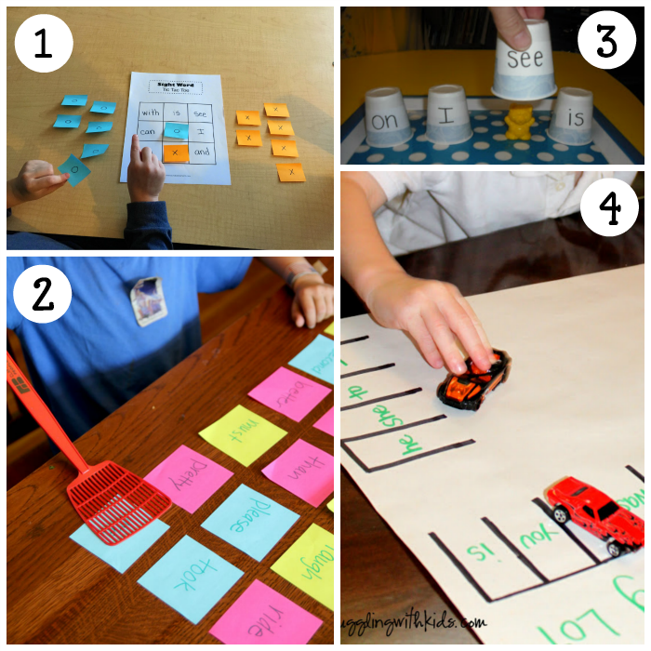
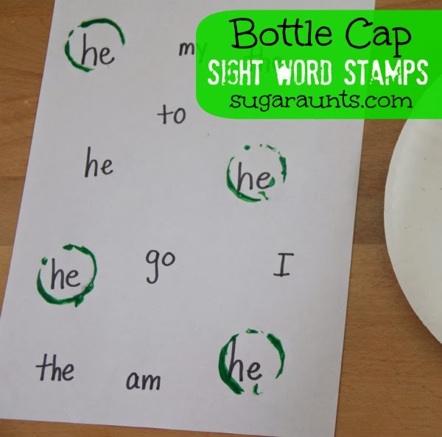
3. Make a sight word car park. Draw your own car parking spaces and write a selection of common exception words in each space.
Child to park their car when they can read the word.
4. Write a selection of the common exception words on paper.
Child to stamp or circle the word when
they can find and read it.

Slide 6

Happy Reading!
Children learn to read by reading.
Continue to listen to your child read on a regular basis.
Encourage them to read a variety of texts such as their school books, books from home, books from the library, comics, recipe books, poetry books, traditional tales, fiction and non-fiction.
Ask them lots of questions about what they have read. Can they retell the story or information? If it’s a story, ask who it was about and what happened. If it’s an information text, ask your child to explain what it was about and how it worked, or what its parts were.
Remember that it is important to continue to read to your child regularly and enjoy sharing a variety of books with them.

Slide 7
Questions to ask your children when reading
COMPREHENSION | INFERENCE (Using clues in the text)
What happened before/after...? What happened at the beginning/middle/end? Which words tell you the order things happened in? Which word shows this is the start/middle/end of the story? Did you like the ending of the story? Why? What is your favourite part of the story? Why? Who do you think is telling this story? Who is the narrator? What does this word mean? How do you know this is a fiction/non-fiction book? What is this? What is it for? Can you find the...? ( index, bold writing, heading, contents, glossary) How is this book organised? How can I find out about...? Can you read this question/exclamation with expression? Has anything like this ever happened to you? | What might happen next? Why have you changed your mind? Tell me what you think about this character. Do you like him/her? Why? Which words (verbs/adverbs) tell you that? Would you like to be friends with this character? Why? Which words tell you that? Why did the character do that...? How does the character feel at this point in the story? Can you find clues in the text and illustrations to show me why you think this? Do you think both characters feel the same? Why?

Slide 8
LANGUAGE FOR EFFECT | THEMES
Can you find any adjectives the author has used to describe the...? Can you find a verb? Why has the author chosen this verb? What other words could the author have used to show the character is feeling...? Choose a word the author has used to describe the character/setting. Tell me why you like it. Can you find an interesting description of a character/setting that you like? Why do you like it? What does this adverb tell us about how the character is feeling? What does this verb (e.g. shouted or grabbed) tell us about how the character is feeling or behaving? What do you notice about the words on this page? Why do you think the author has written the words on the page like that? Can you spot any patterns in these sentences? Can you spot any words which rhyme? Can you think of another rhyming word the author could have used? What comes next? Can you join in? | What is the title of this book? Why did the author choose this title? What does it tell us about the book? What type of story is this? How do you know? Where or when is this story set? Which words have been used to start this story? Why? How else could the author have started/ended this story? Which other stories have you read with similar themes/settings/characters/events? Which other stories have you read by this author? What is similar about these stories? What sort of characters will we find in this story? What usually happens to baddies/goodies in fairytales?

Slide 9
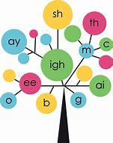
Phonics
In Year 1, children use phonics as a method of helping them to read. It involves matching the sounds (phonemes)of spoken English with individual letters or groups of letters(graphemes)
Once children know the graphemes and phonemes for Year 1, they can segment and blend them to read and spell lots of new words.
Children in Year 1 are currently working at Phase 2, Phase 3, Phase 4 or Phase 5. They should be able to tell you which of these groups that they are in.

Slide 10
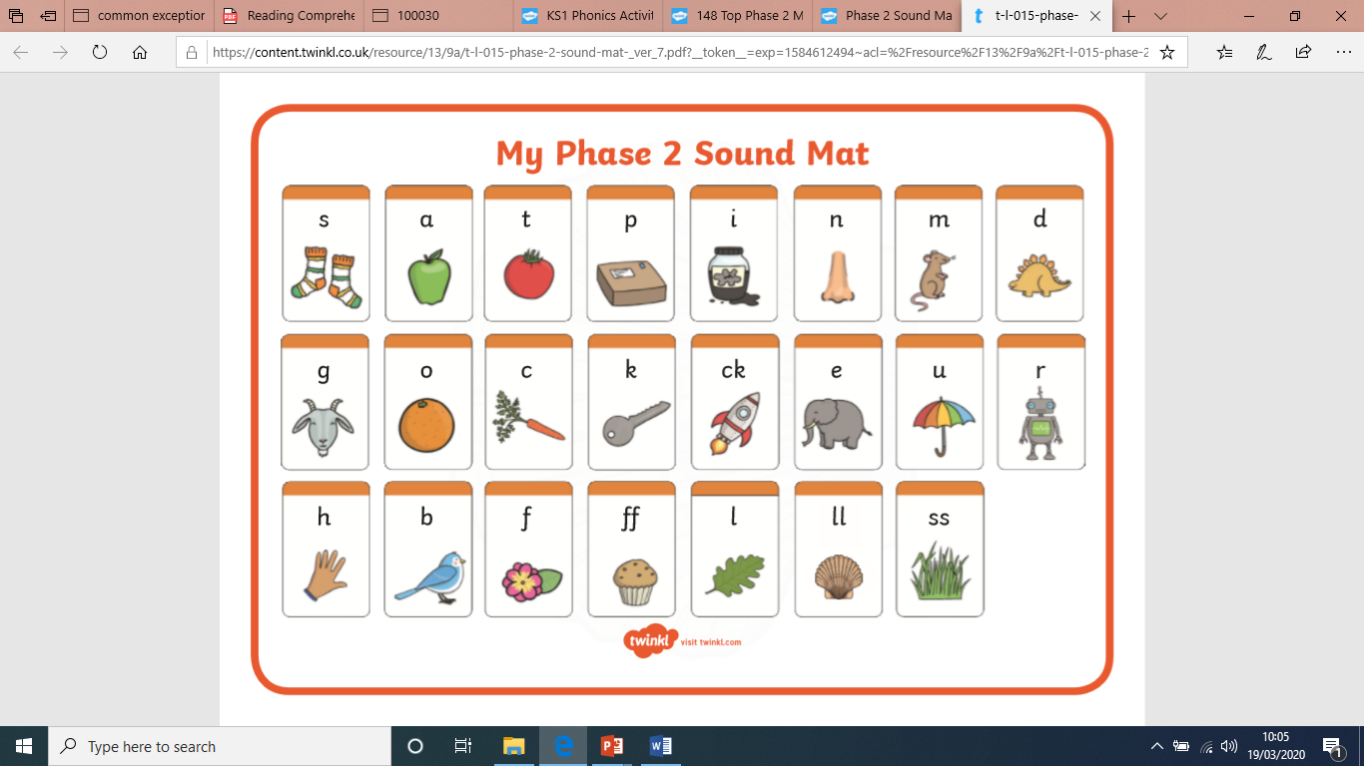
Phase 2 Phoneme (Sound) Mat
Do you know all of the phonemes (sounds) for all of the letters (graphemes) in Phase 2?

Slide 11
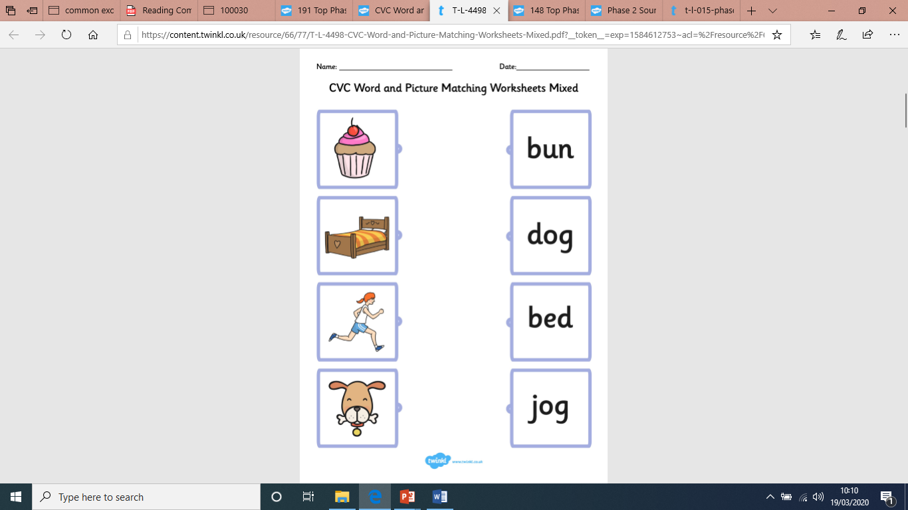
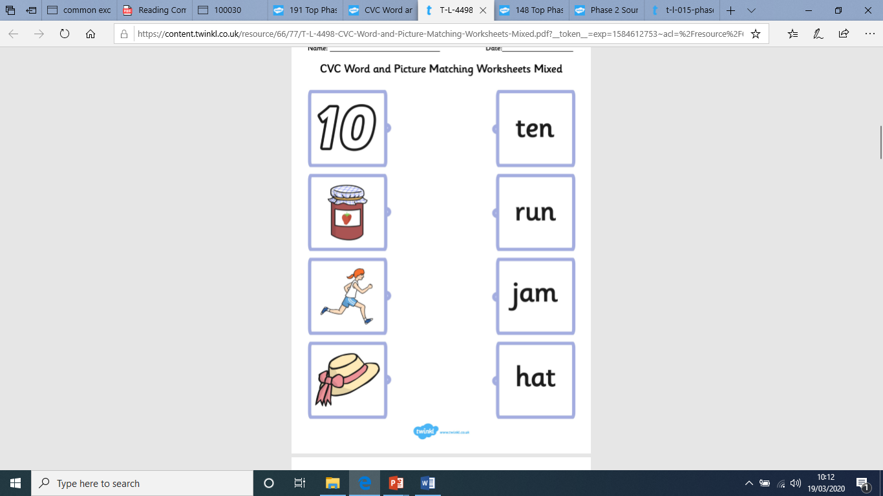
Can you match the picture to the correct word?

Slide 12
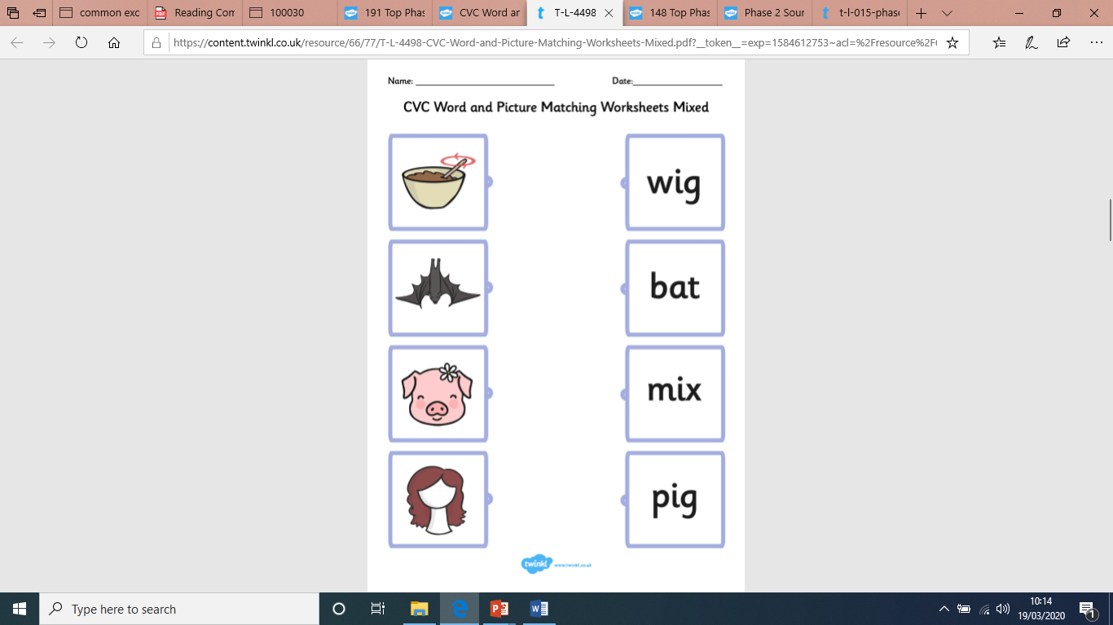
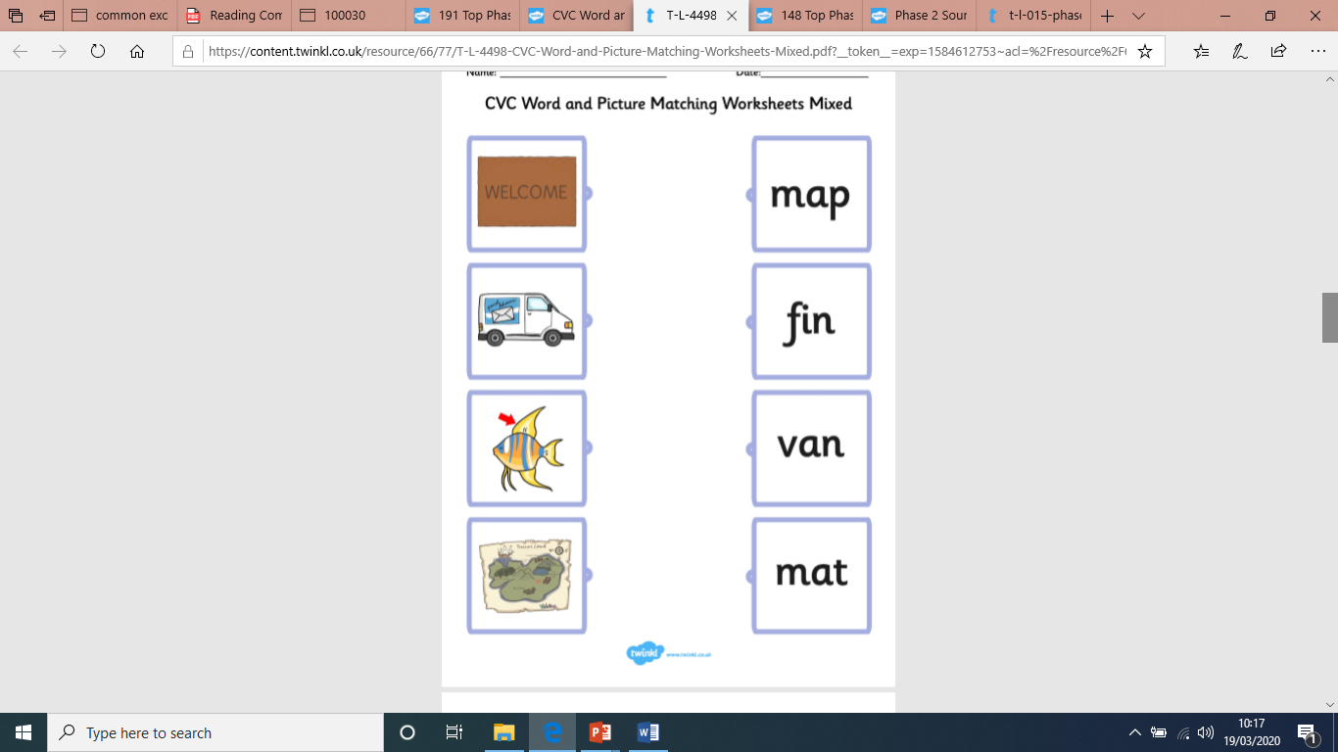
Can you write the words too? Your grown up could read the word aloud and you could write it on
paper or in a book.

Slide 13
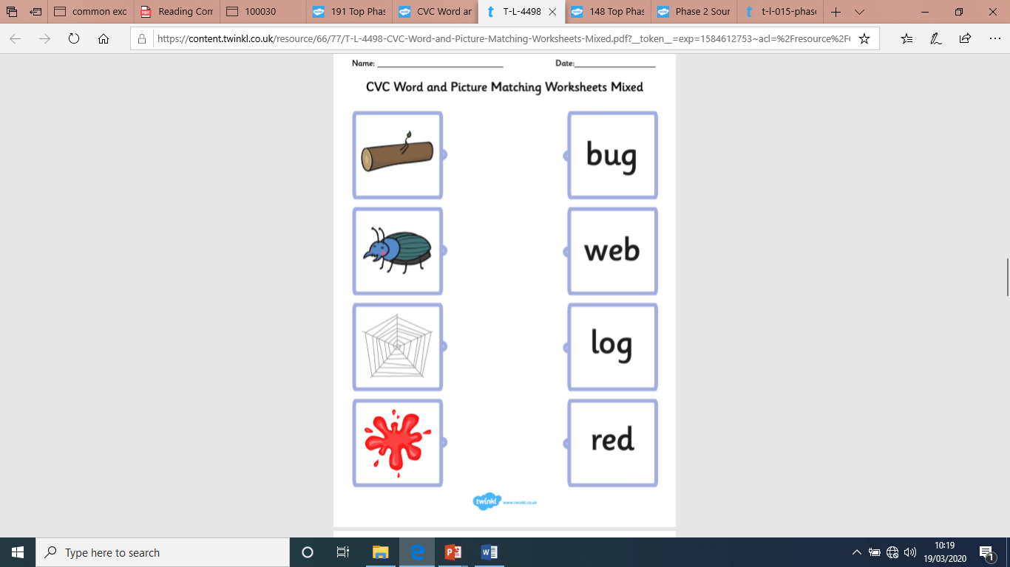
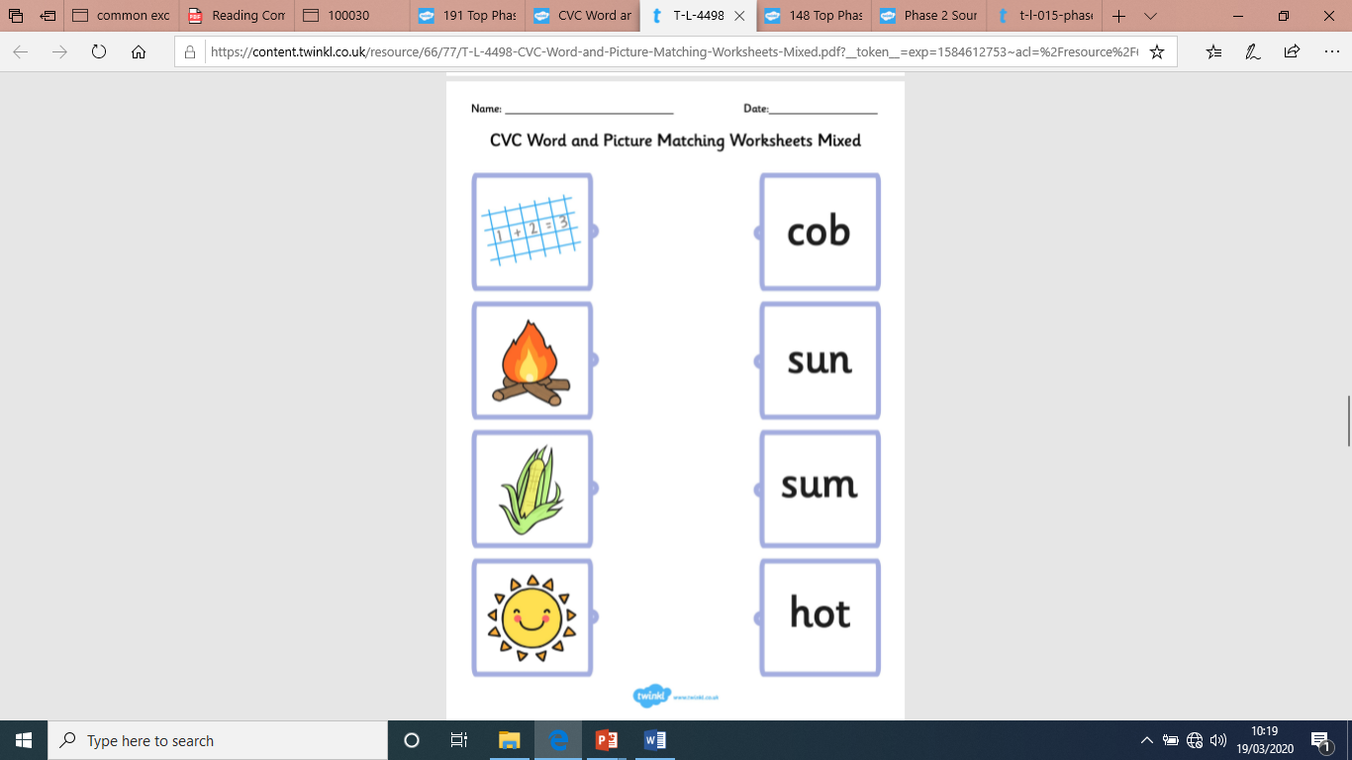

Slide 14
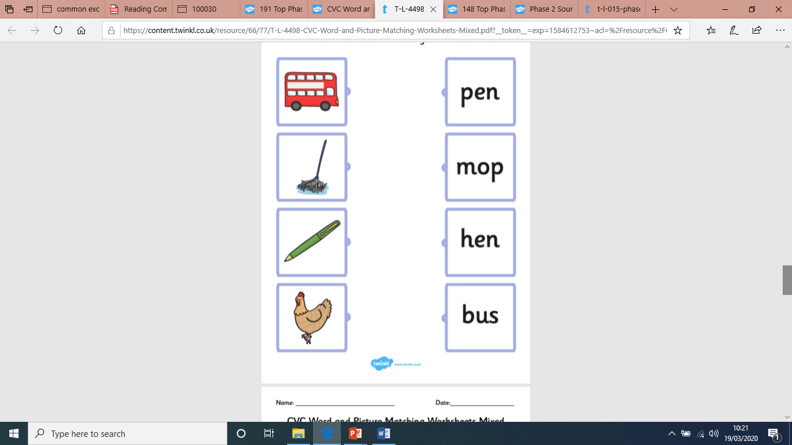
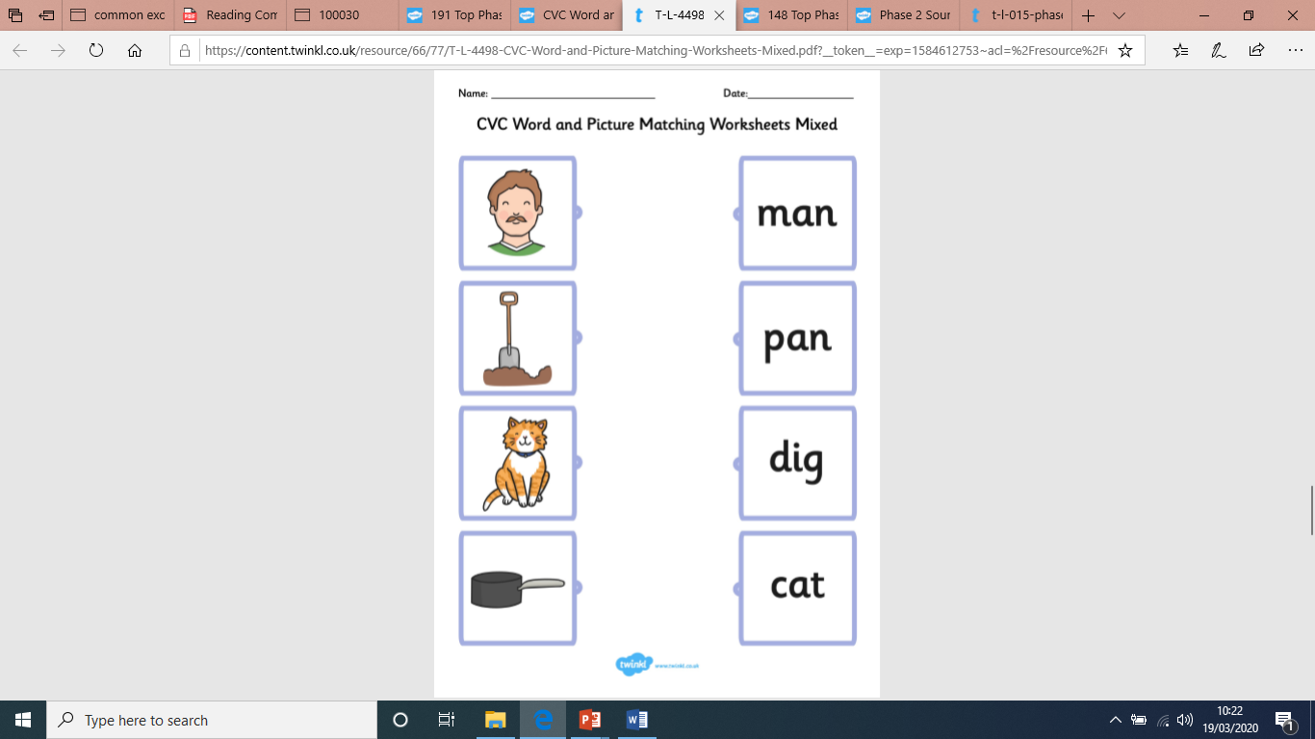

Slide 15
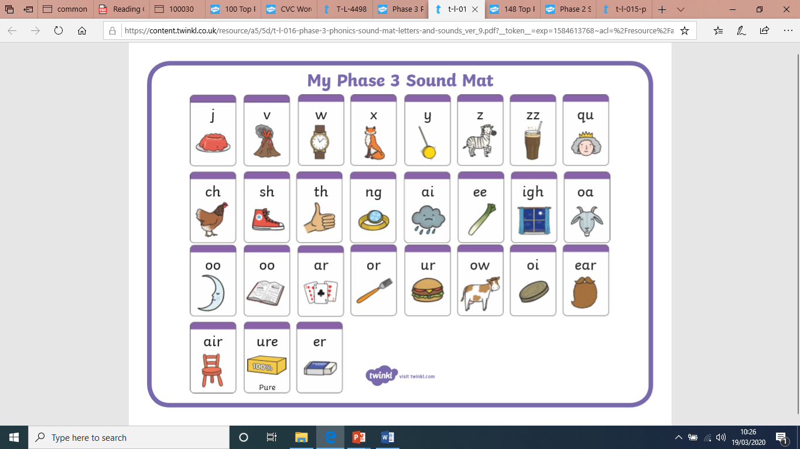
Phase 3 Phoneme (sound) mat
Do you know all of the phonemes (sounds) for all of the letters (graphemes) in Phase 3?

Slide 16
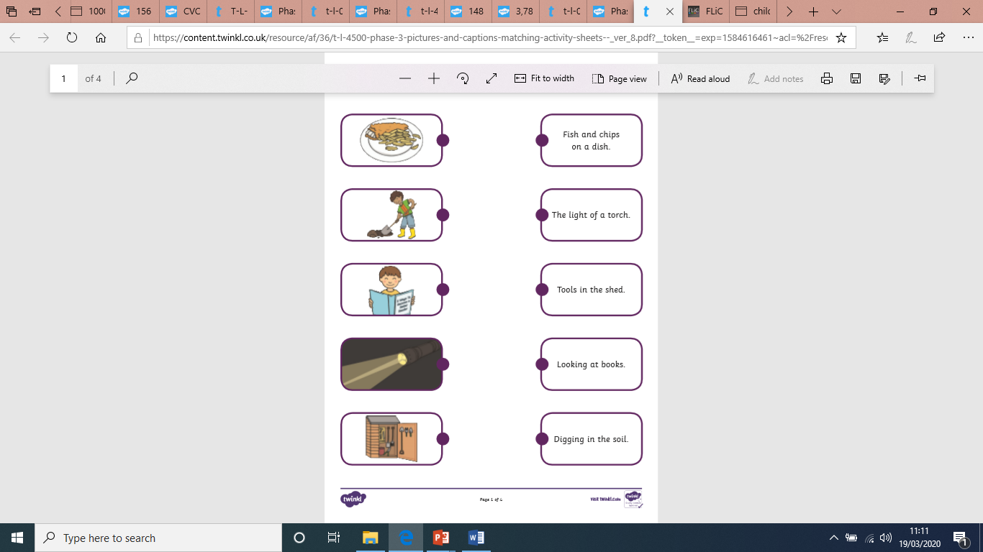
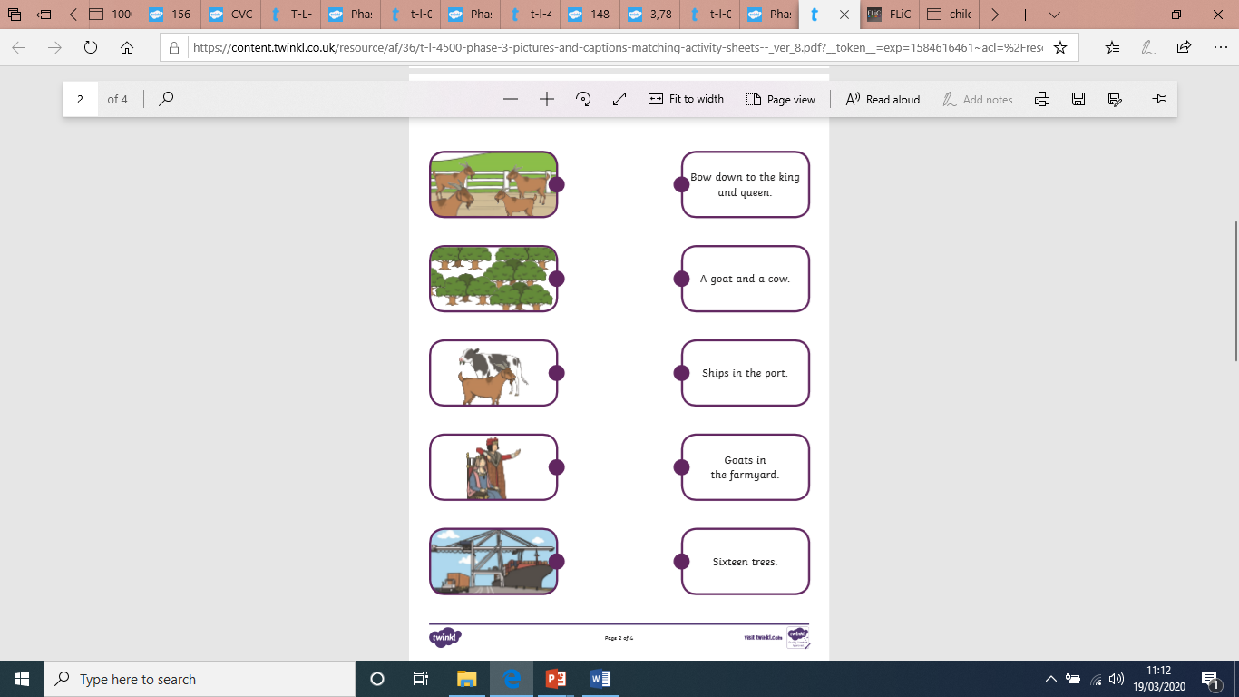
Can you match the picture to the correct caption?

Slide 17
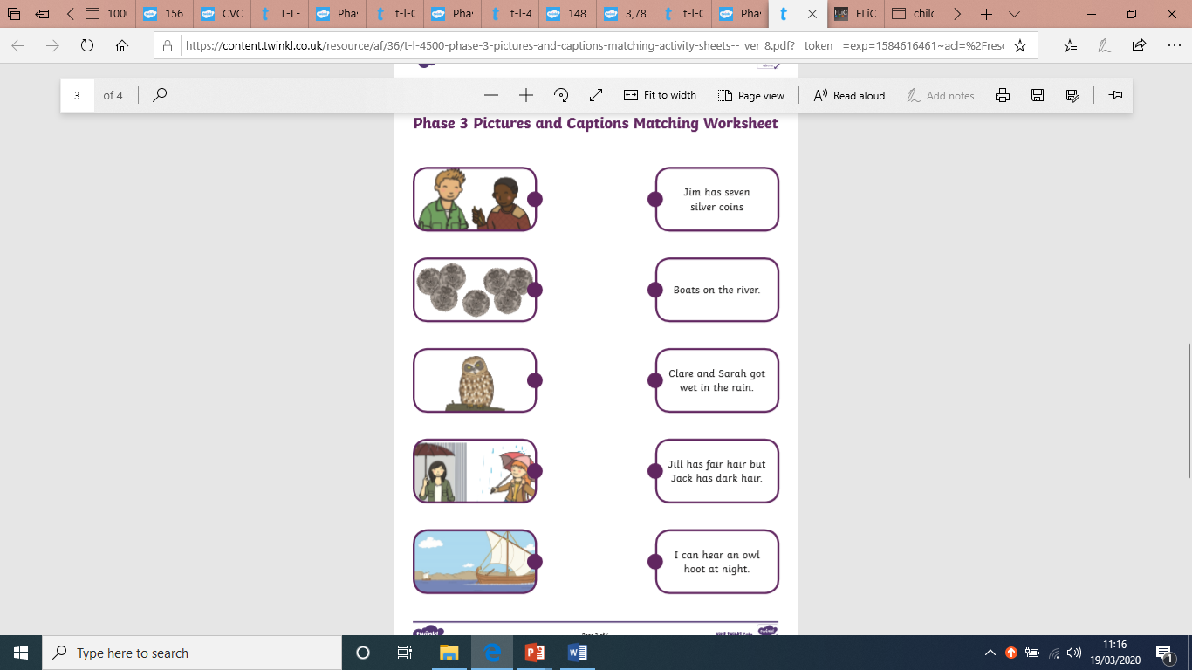
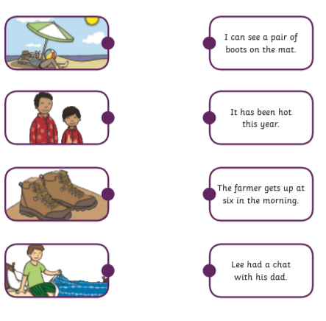
Can you also write the captions? Your grown up could read the captions and you could write them on
paper or in a book.

Slide 18
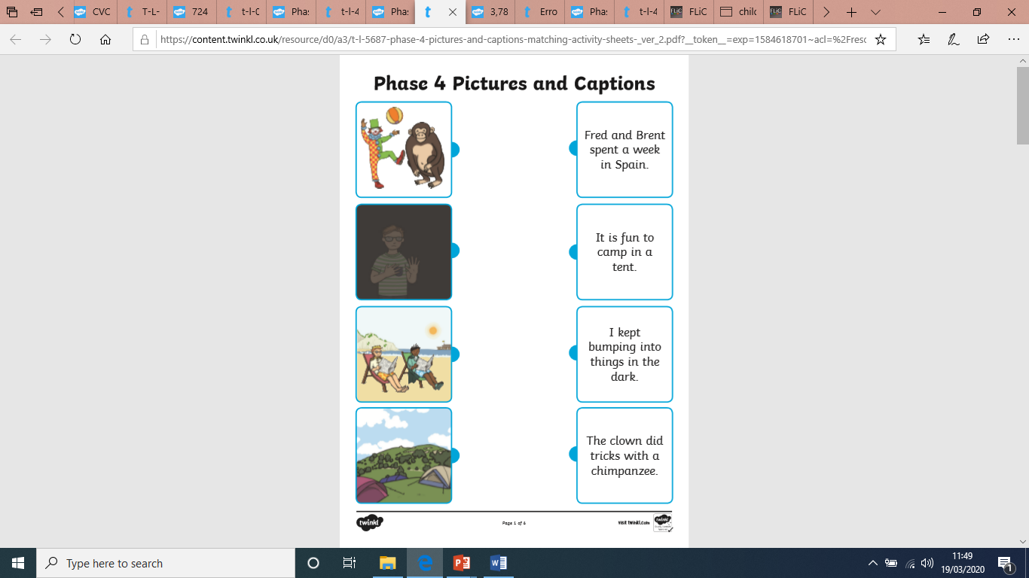
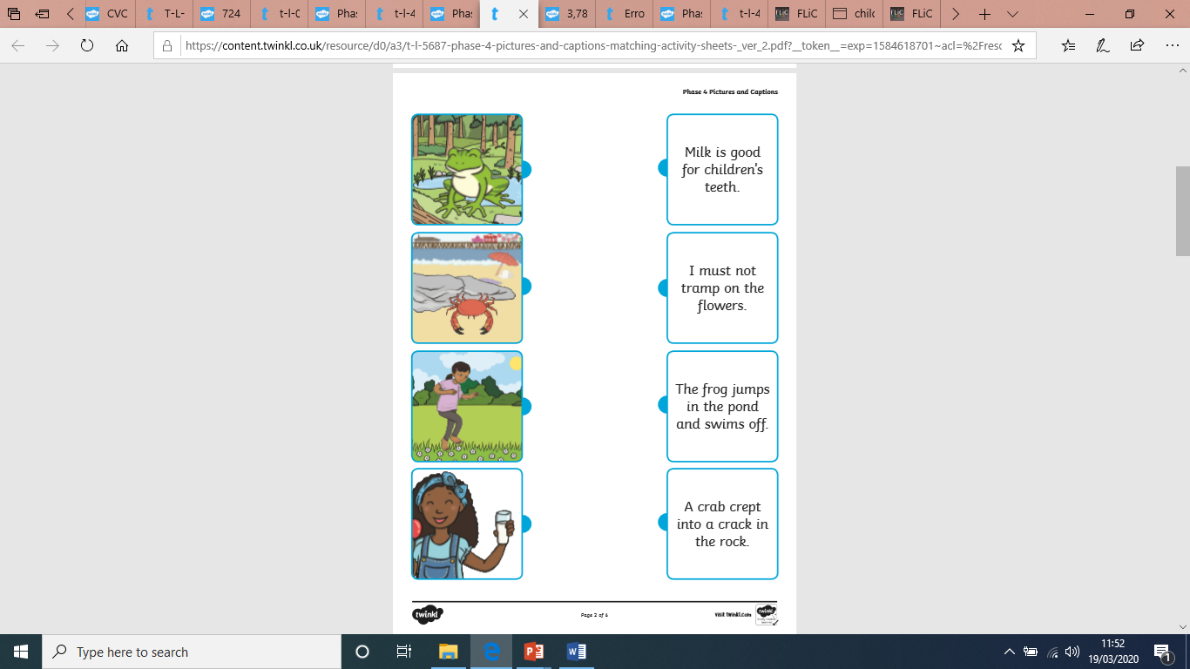
Phase 4
Can you match the picture to the correct sentence?

Slide 19
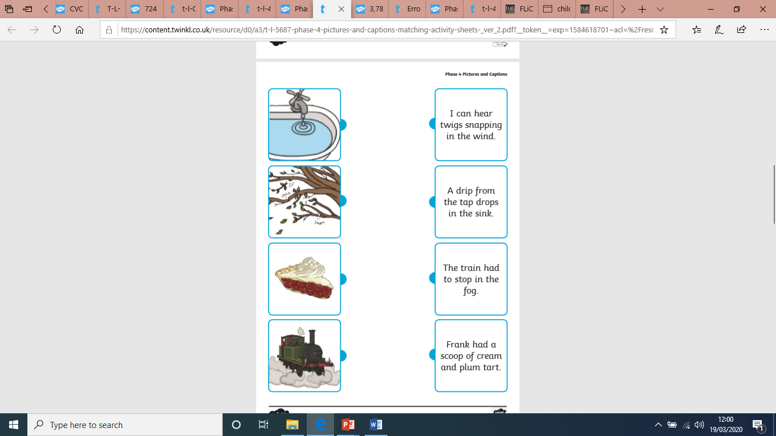
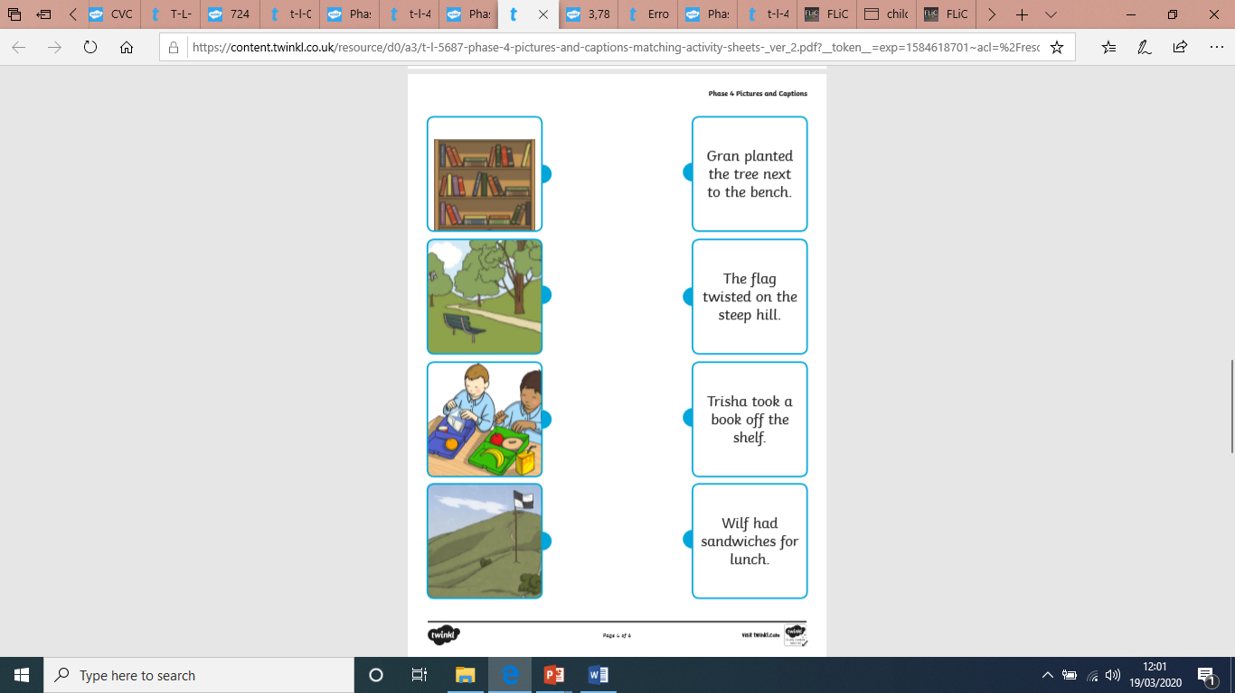
Can you also write the sentences? Your grown up could read the sentences and you could write them on paper or in a book.

Slide 20
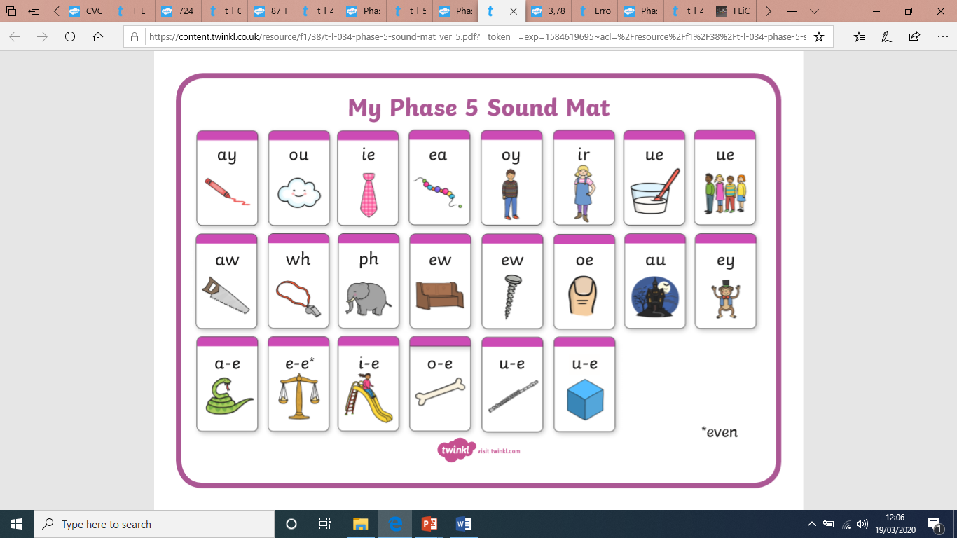
Phase 5 Phoneme (sound) mat
Do you know all of the phonemes (sounds) for all of the letters (graphemes)in Phase 5?

Slide 21
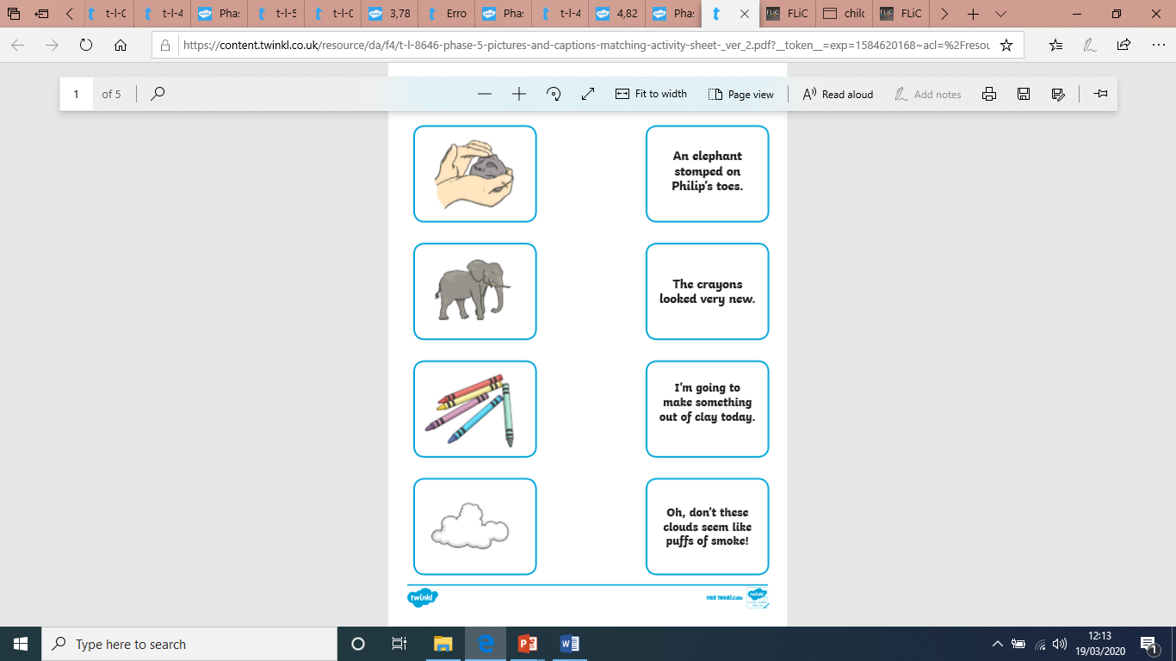
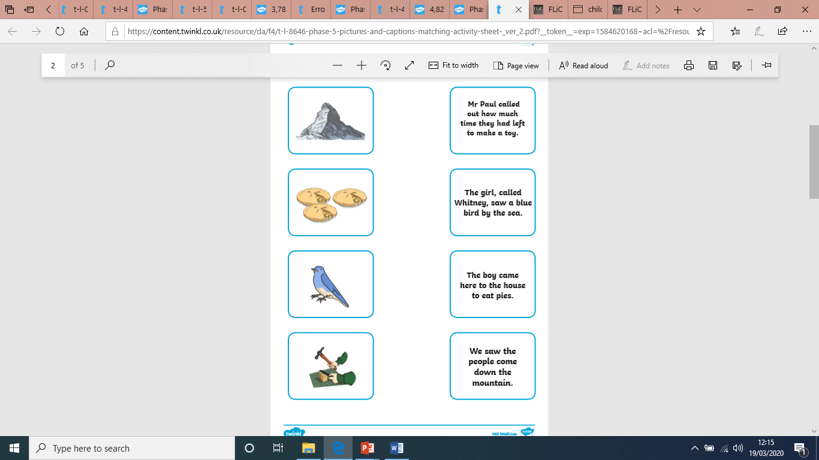
Can you match the picture to the correct sentence?

Slide 22
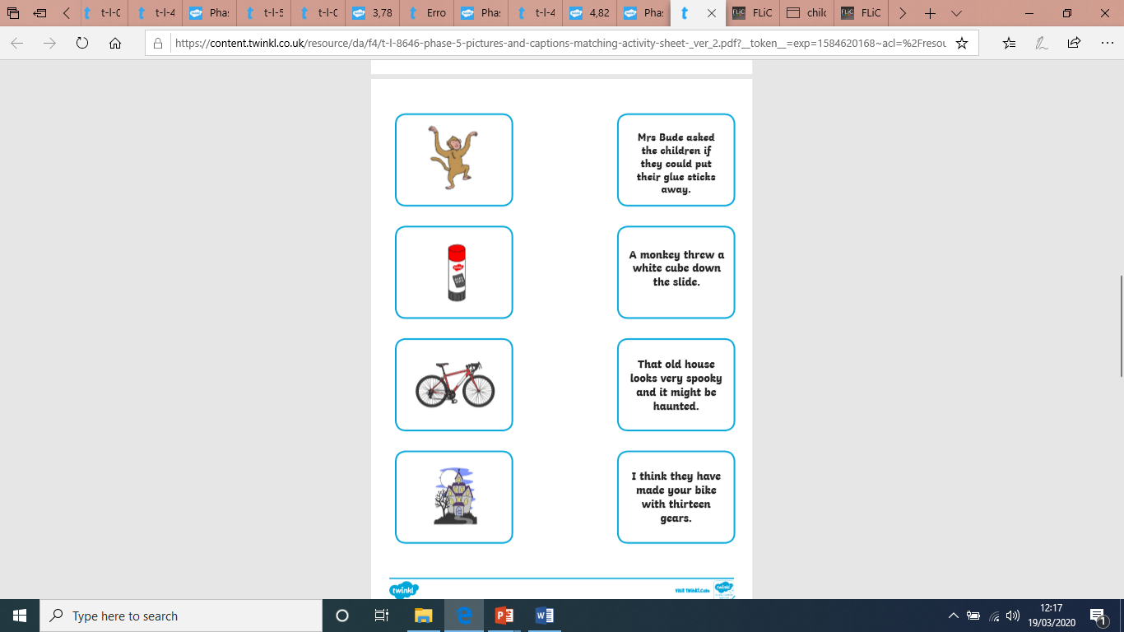
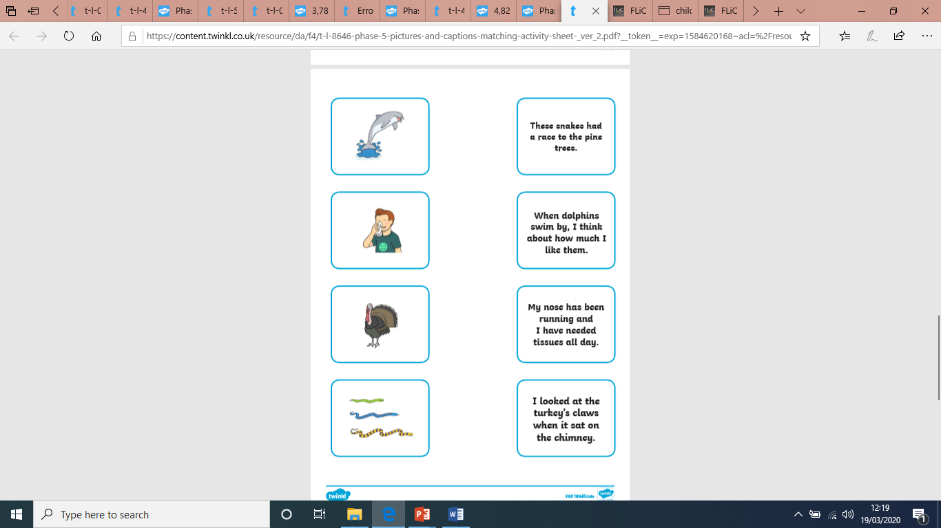
Can you also write the sentences? Your grown up could read the sentences and you could write them on paper or in a book.

