Slide 1

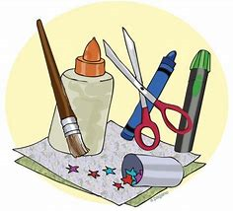

Year 1
Topic

Slide 2

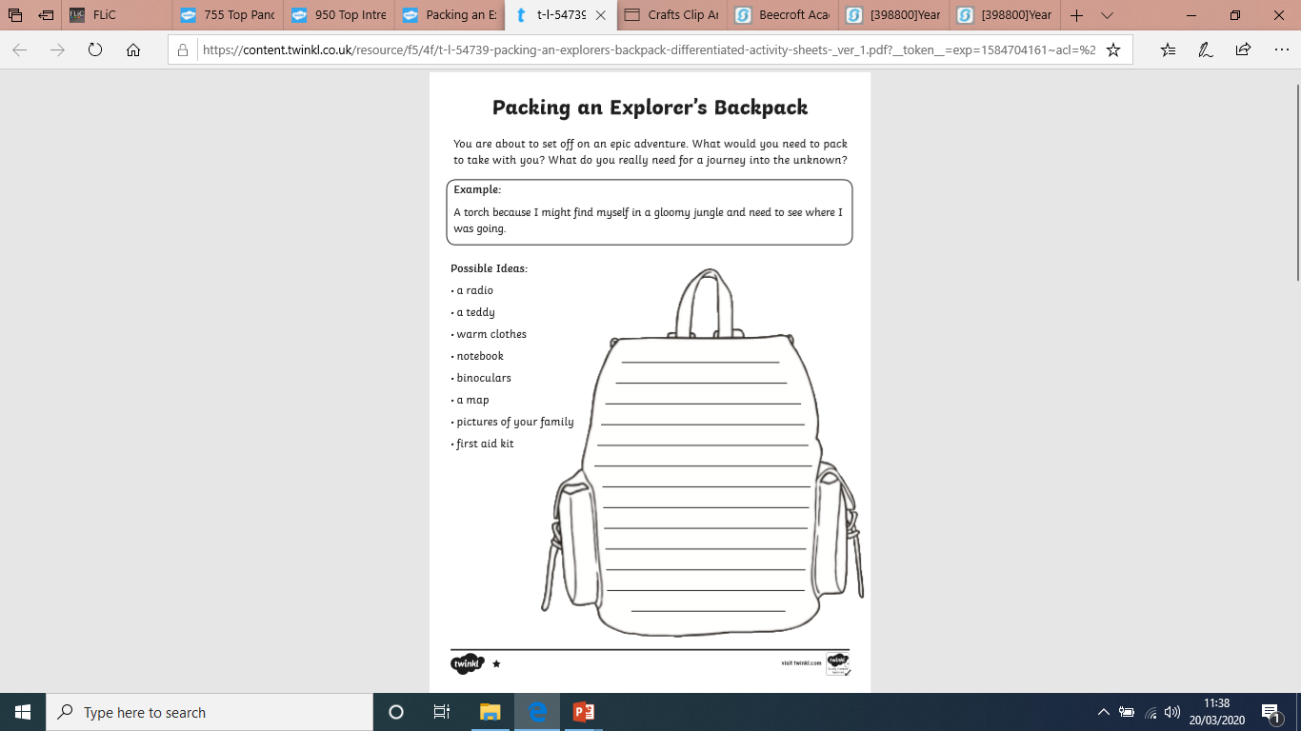
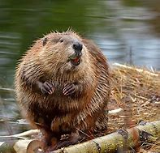
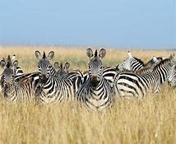
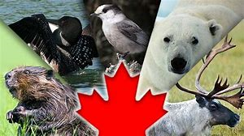
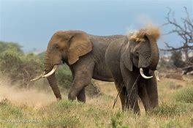
Intrepid Explorers
You are about to set off on an exciting adventure to Canada or Kenya. What would you need to pack to take with you?
Example-A pair of binoculars so I can see the animals clearly.

Slide 3
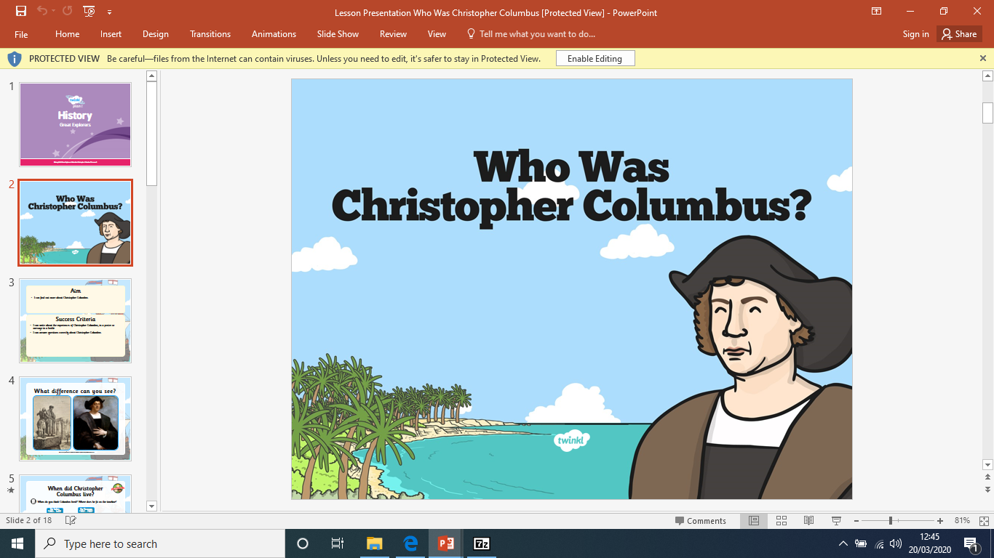
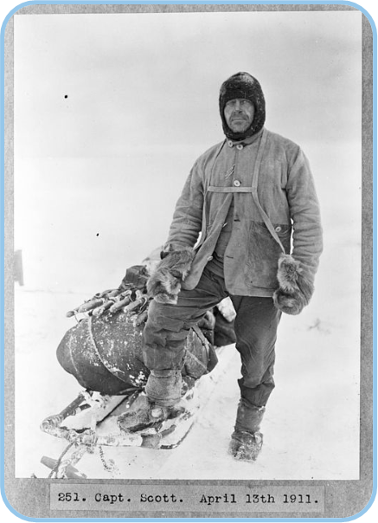
Find out about a famous ‘Intrepid Explorer’ from history’
Who Was Captain Scott?

Slide 4
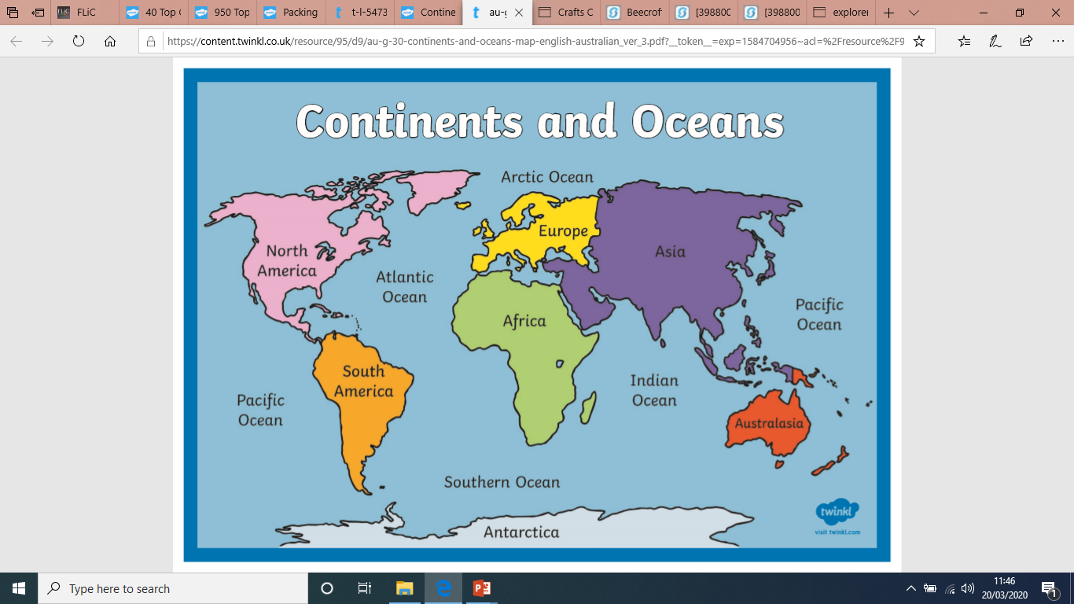
Can you name the Continents and Oceans of the world?
Where is Canada and Kenya?

Slide 5

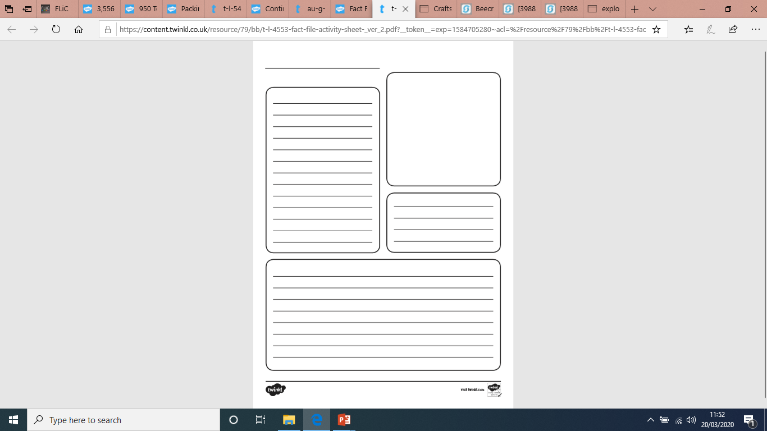



Produce your own Canada or Kenya fact file. Use the internet, books and other sources to help with your research. Here are some ideas of what could be included and how you could set your fact file out.
T
Title
Weather Facts
The Flag
Language spoken
Animals you will find there
Capital city
Currency
Landmarks

Slide 6
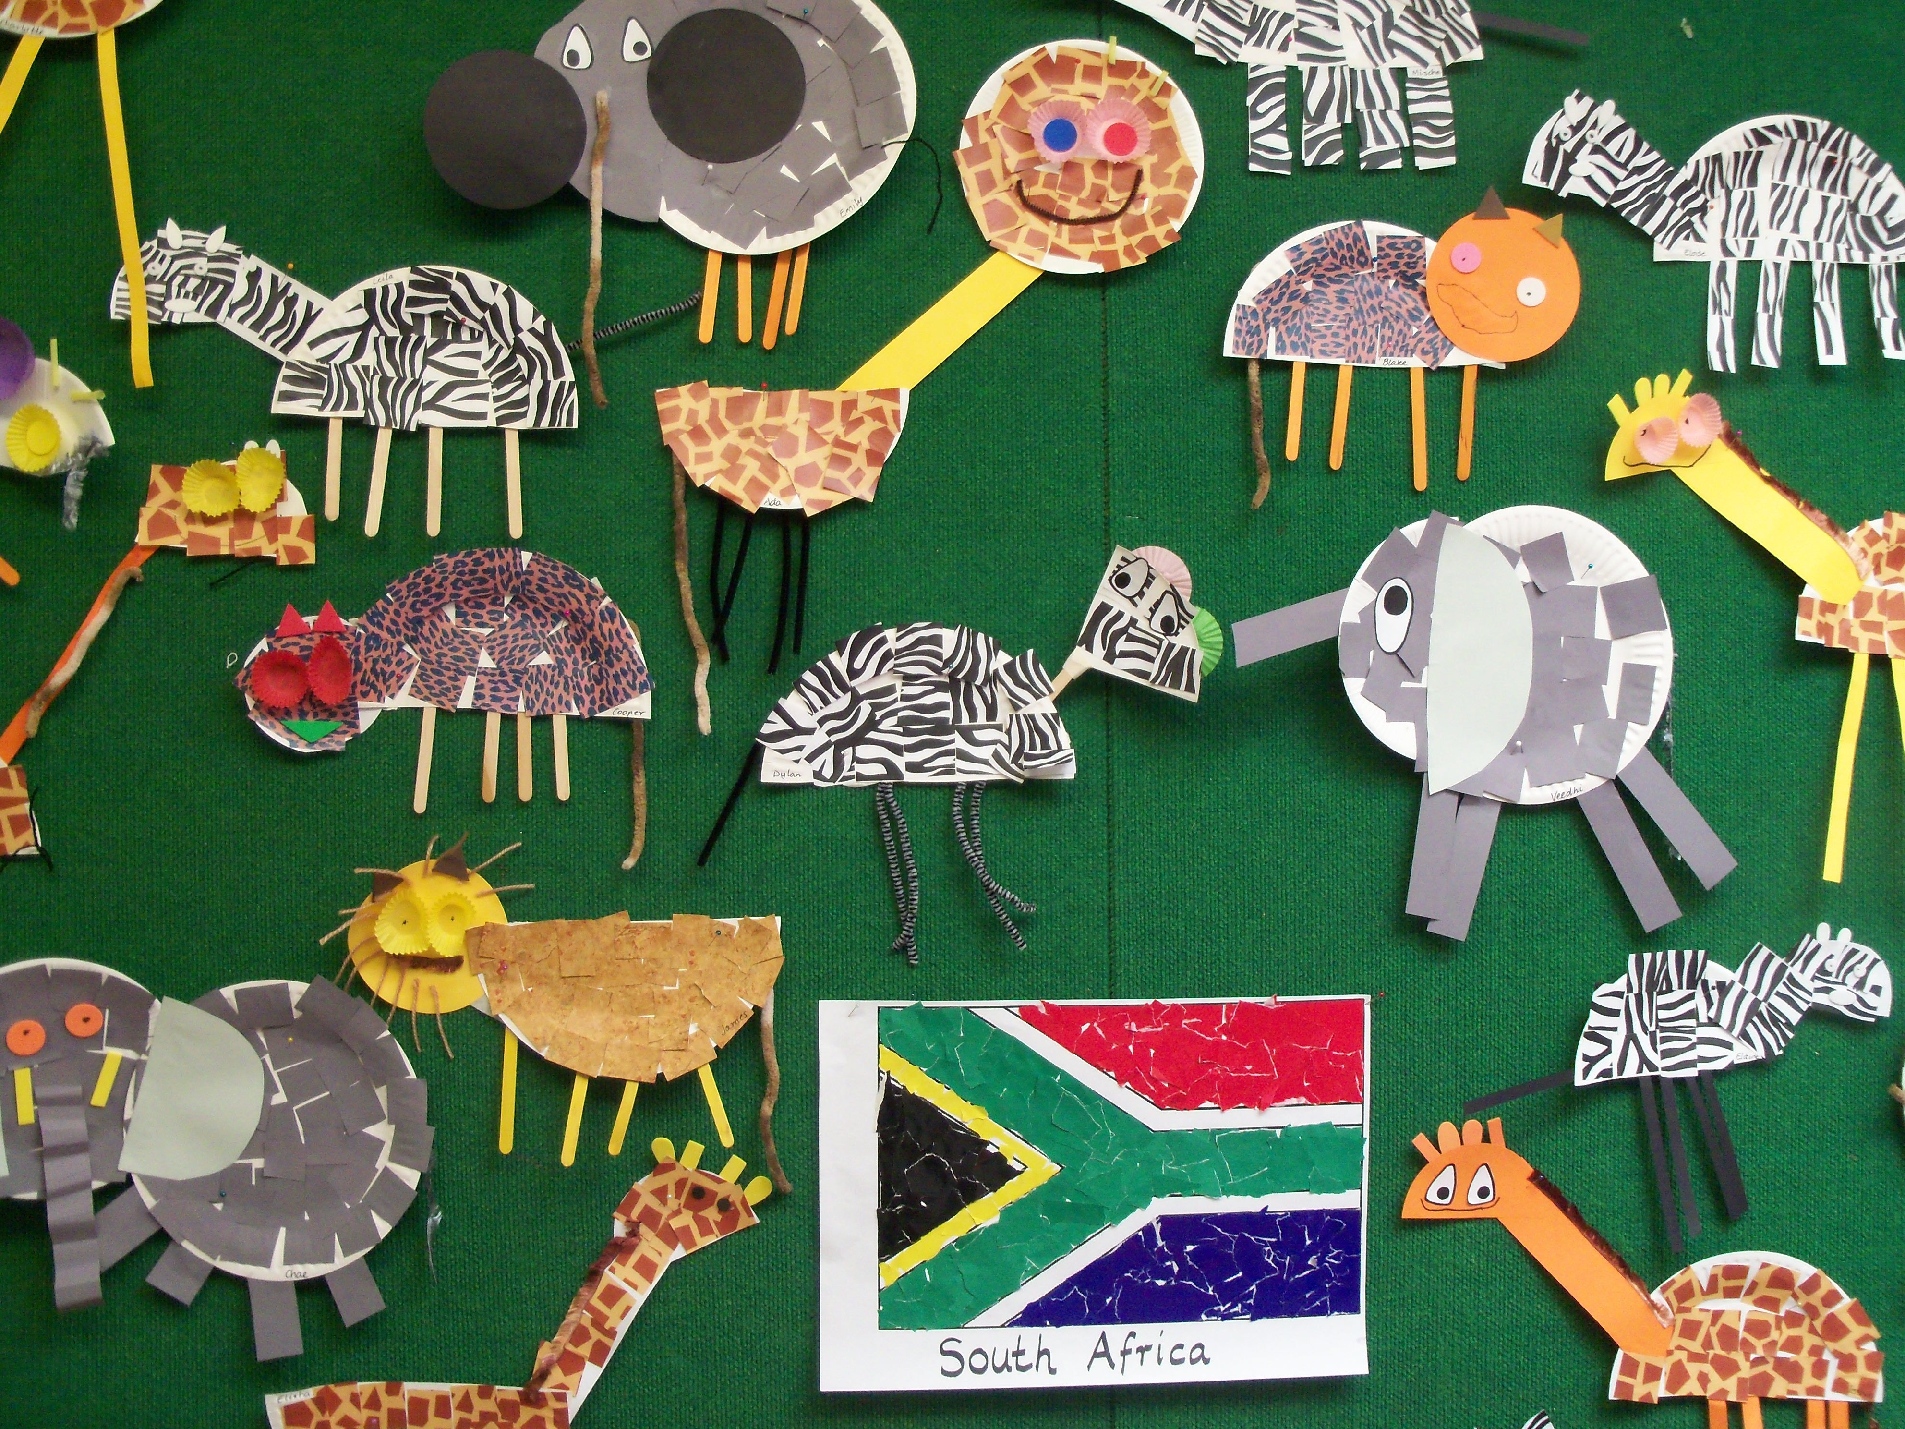
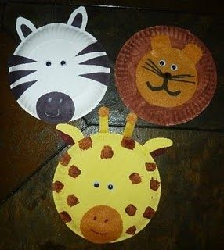
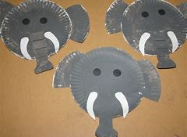
Produce a Kenyan Safari piece of artwork.
Use paper plates and other materials such as card, paint, pipe cleaners, tissue paper and other collage materials to make your own animal.
Can you find out some facts about your Safari animal?

Slide 7
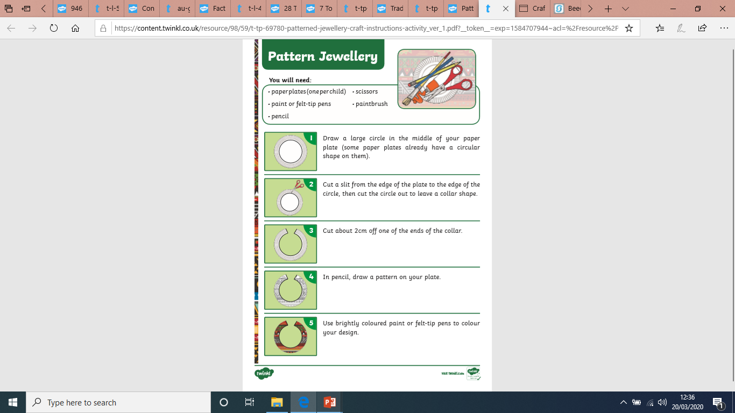
Make an African inspired piece of jewellery by following the instructions

Slide 8
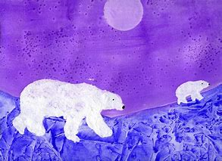
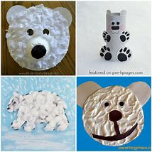

Make a Canadian Arctic polar bear picture or model.
Cotton wool is a great material to use for a Polar Bear.

Slide 9
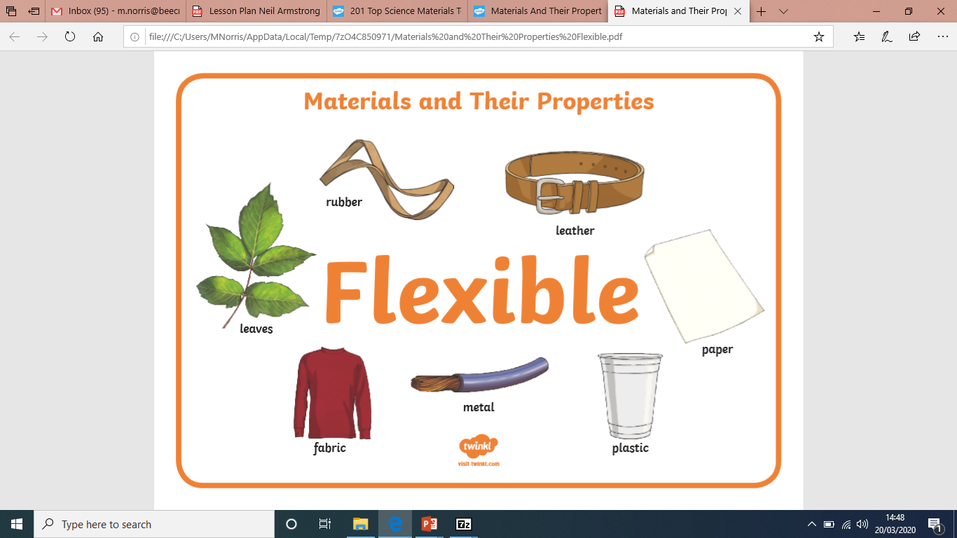
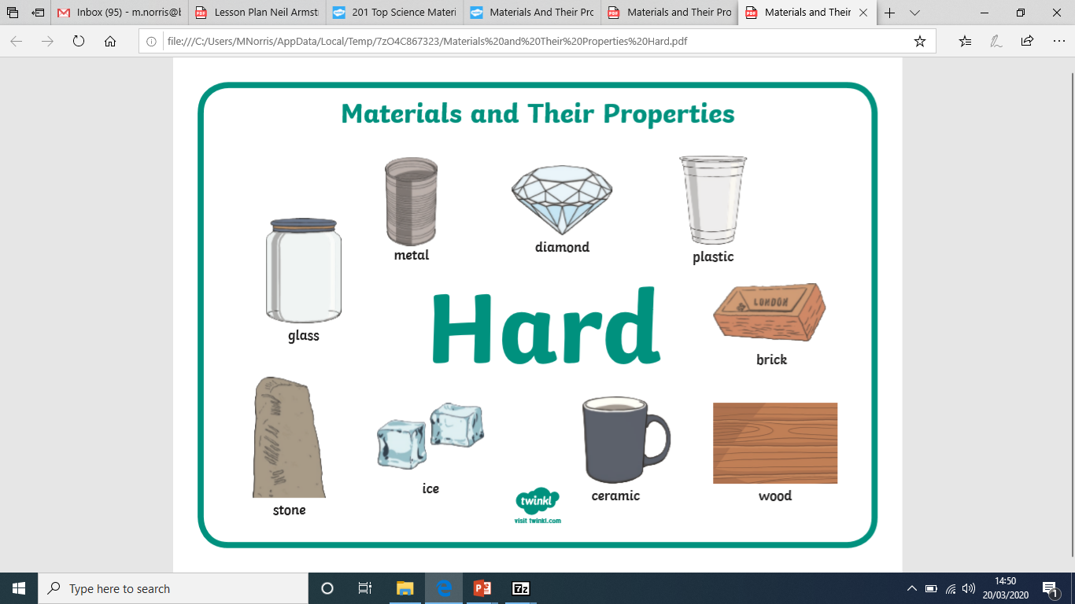
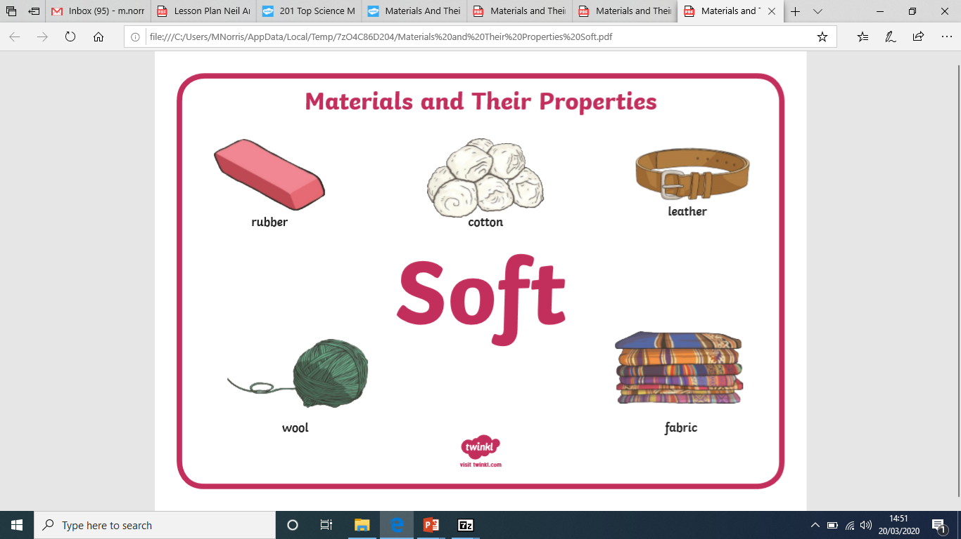
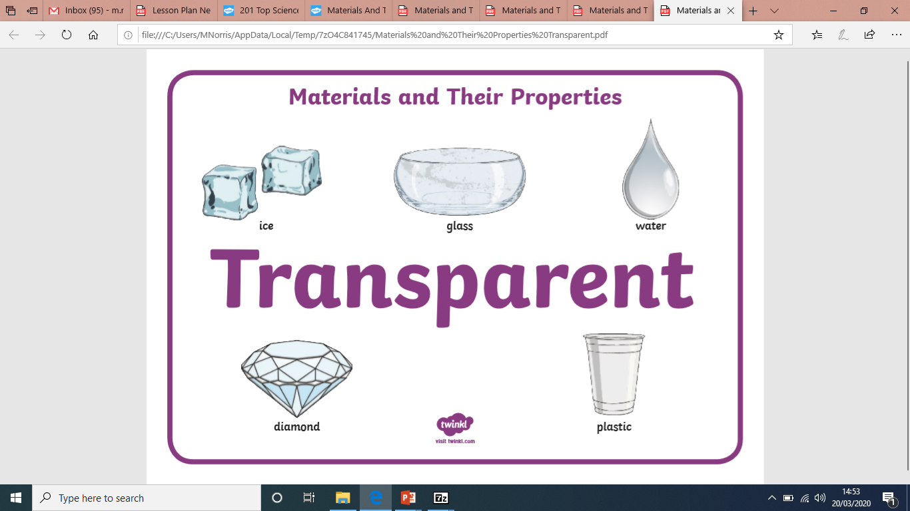
Science-Materials

Slide 10
Go on a ‘Material Hunt’ around your house. How many things can you find that are flexible, hard, soft or transparent? Draw and label what you find.
Flexible | Hard
Soft | Transparent

Slide 11
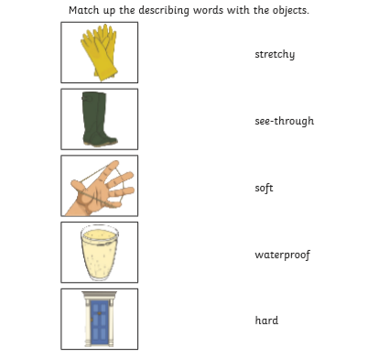
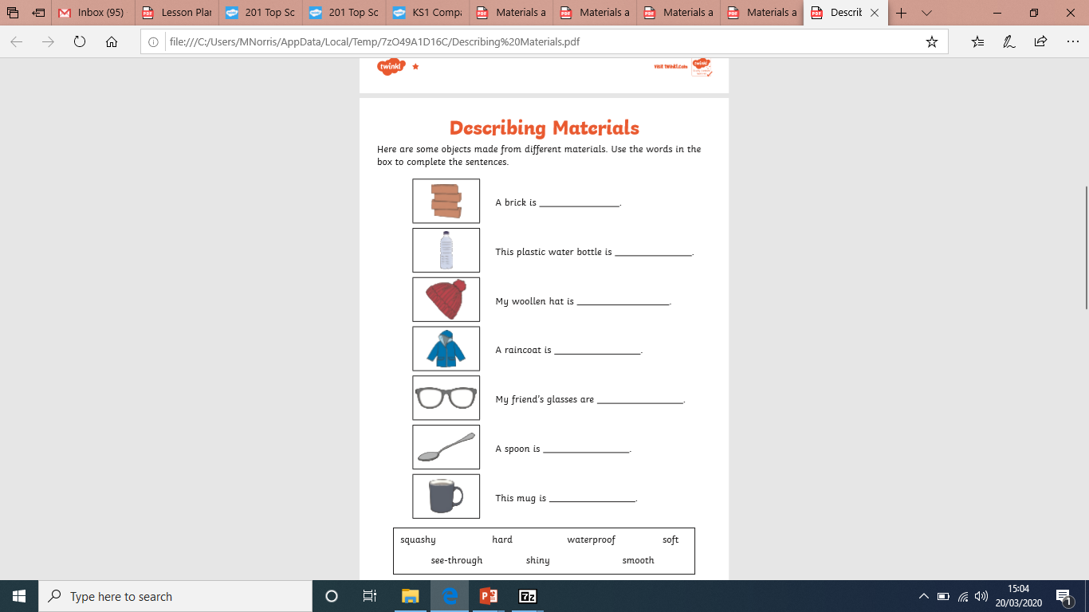
Describing Materials

Slide 12
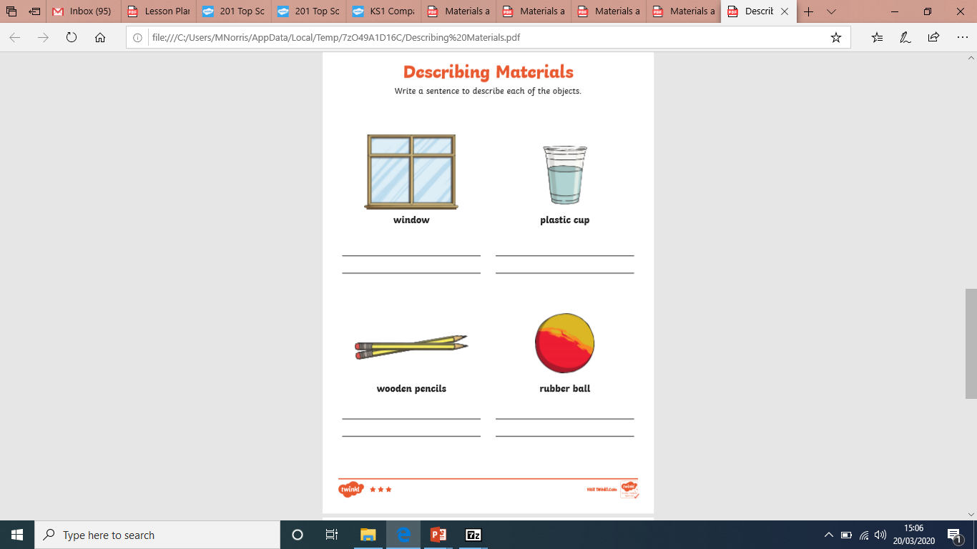
Describing Materials

Slide 13
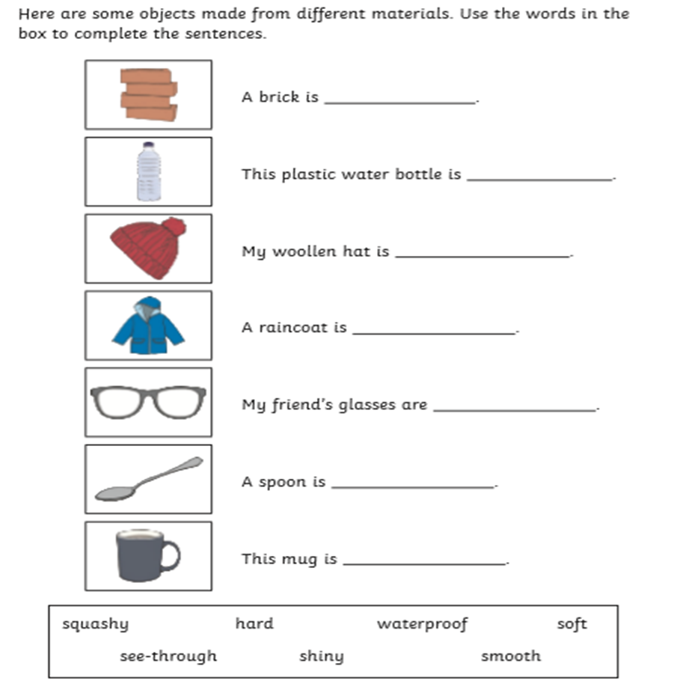
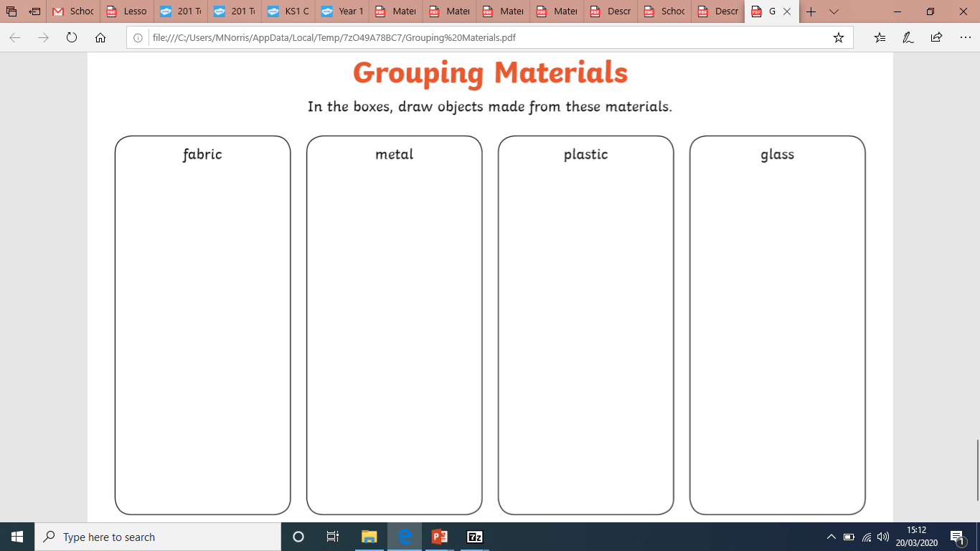
Grouping Materials

